Slide 1

HACCP systems

Slide 2
Aims
To assist officers with the audit of HACCP systems and systems based on HACCP principles

Slide 3
Objectives
This course seeks to:
  Review the 7 Codex Principles of HACCP.
  Review prerequisites to HACCP
  Review “Systems based on HACCP principles”.
  Consider compliance with Article 5, 852/2004.
  Provide practical guidance on assessment of compliance and appropriate enforcement.

Slide 4
Programme
Day 2 Audit of HACCP systems
10:00 Role of Local Authorities
Approach to audit
11:00 Coffee
11:15 Approach to audit continued
13:00 Lunch
13:45 Practical workshop
15:00 Coffee
15:15 Practical workshop continued
16:00 Close

Slide 5
Programme
Day 3
10:00 Practical workshop continued
11:00 Coffee
11:15 Practical workshop
12:30 Audit of systems based on HACCP principles
13:00 Lunch
13:45 Risk rating
Enforcement
15:00 Close

Slide 6
Introduction

Slide 7
History
The Pillsbury Company working with NASA
Collaborative effort to develop safe food for Astronauts involved in the United States space programme
  Prevent illness that might cause aborted mission
  Wanted close to 100% assurance that food was not contaminated

Slide 8
History
HACCP concept was developed and has since been used by the food industry as a tool for ensuring food safety
HACCP principles further developed and have international recognition

Slide 9
HACCP
HACCP
  food safety management system
Used by food industry at different levels:
  Codex Alimentarius Commission (CAC)
    “Pure”, “Full blown HACCP”
  Systems based on HACCP principles
    legal requirement (852/2004 Article 5)
  Home made systems
    Somewhere in between

Slide 10
Codex HACCP

Slide 11
Principles of HACCP
Codex alimentarius
  HACCP System and Guidelines for its Application
    CAC/RCP-1 (1969), Rev 4 (2003)
Internationally recognised system
  Not legal requirement in EU
  Compliance with Codex HACCP will satisfy legal obligations (if fully implemented)

Slide 12
Seven Principles
Conduct a Hazard Analysis
Determine the Critical Control Points
Establish Critical Limits
Establish monitoring procedures
Establish corrective actions
Establish verification procedures
Establish record keeping and documentation

Slide 13
Preliminaries

Slide 14
Preliminaries
Before embarking on HACCP should consider:
  Prerequisites
Essential for successful HACCP
Provide basic environment & operating conditions
Prerequisites based on:
  Legal requirements i.e Annex II 852/2004
  Good Manufacturing Practice
  Codex Alimentarius General Principles

Slide 15
Pre-requisites
HACCP involves:
  Review & assessment of existing pre-requisites
Any environmental hazards not controlled by pre-requisites should be included in HACCP

Slide 16
Pre-requisites
Pre-requisite issues include:
  Supplier control
  Specifications
  Storage and transport
  Equipment
  Personal hygiene
  Temperature control
  Training
  Cleaning
  Pest control
  Product withdrawal

Slide 17
Pre-requisites
Working knowledge of:
  Premises
    Ancillary buildings
  Equipment
  Operations
    Layout
    Characteristics
  Microbiology
  Hygiene
    Segregation of high & low risk areas
  Food technology

Slide 18
Preparing a HACCP

Slide 19
Preparing a HACCP
Integrity and effectiveness of HACCP relies on detailed preparation.
Generic plans available
  Canadian Food Inspection Agency (www.inspection.gc.ca)
  MyHACCP (https://myhaccp.food.gov.uk/)

Slide 20
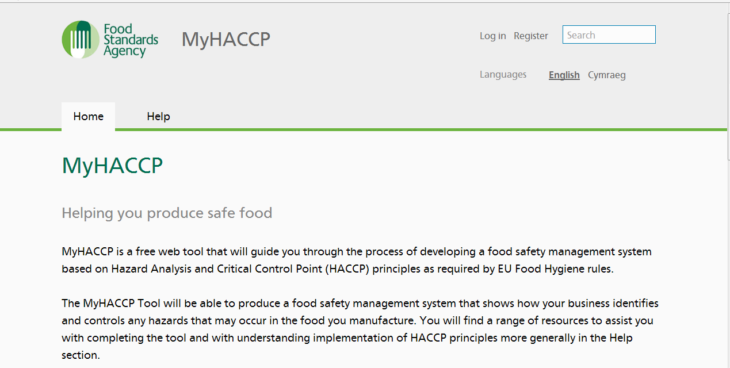
MyHACCP
https://myhaccp.food.gov.uk/

Slide 21
MyHACCP
Provides businesses with:
  Web tool that leads them through a HACCP study protocol
    Focus is on their products
    also considers the prerequisites

Slide 22
MyHACCP
Tiered guidance on:
  Preparation for a HACCP study
  Working through each of the HACCP principles
  Identification of hazards, their analysis, CCPs and control

Slide 23
MyHACCP
External web links to relevant information
Pdf output of
  the finished HACCP study and;
  HACCP based controls.

Slide 24
HACCP – First Steps

Slide 25
HACCP team
Responsible for undertaking HACCP
Should include representatives from all aspects of business
In large premises, could include:
  Production manager
  Process engineer
  Operator(s)
  QA/Technical manager

Slide 26
HACCP team
In small premises
  Food Business Operator
  Staff
Team must have access to technical information to be effective

Slide 27
Description of food
HACCP team must understand key characteristics of food
  Chemical composition
  Physical state
  Packaging
  Shelf life
  Labelling information

Slide 28
Intended use
Ready to eat
  Further processing by customer
Target group:
  Elderly/infants
Likelihood of misuse
  Temperature abuse
  Preparation of food

Slide 29
Process Flow diagram
Include main steps in process
Easy to read

Slide 30
Process Flow diagram (PFD)
Identifies all key stages of the food activity
From purchase and receipt of raw materials to the supply of the finished food
PFD should be detailed enough to identify key stages but not over complicated

Slide 31
Verification of flow diagram
Members of HACCP team ‘walk the process’
  Verify that process flow & plan are accurate
  Check for consistency
    E.g. different shifts
  Rectify immediate problems
  Ensure consistency to aid with effective HACCP implementation

Slide 32
Codex seven principles
Conduct a Hazard Analysis
Determine the Critical Control Points
Establish Critical Limits
Establish monitoring procedures
Establish corrective actions
Establish verification procedures
Establish record keeping and documentation

Slide 33
Principle 1
Conduct a Hazard Analysis

Slide 34
Principle 1
Conduct a Hazard Analysis
  Identify significant hazards
    Reasonably likely to occur
    Likely to cause illness/injury if not controlled
    Hazard refers to safety not quality issues
    Correct hazard identification = essential step
  Identify appropriate control measures.

Slide 35
Principle 1: In practice
Purpose of Hazard Analysis:
  Produce list of significant hazards
    That are reasonably likely to cause injury/illness
    If not controlled
  Hazards that are not reasonably likely to occur do not need to be considered further

Slide 36
Principle 1: In practice
Brainstorming session to identify hazards
  List out possible hazards (long list)
    Specific to food
    Consider
      Intrinsic factors
      Extrinsic factors

Slide 37
Principle 1: In practice
Intrinsic factors of food
  Factors that might promote/control pathogen growth
    pH, aw, salt content etc
  Normal micro flora of food

Slide 38
Principle 1: In practice
Extrinsic –
  Temperature
  Humidity

Slide 39
Principle 1: In practice
Review process operations for hazards
  Examine each step of flow diagram
  Consider any hazards that might occur
  Consider
    Product flow
    Personnel flow
      Identify any step where contaminant could be introduced

Slide 40
Principle 1: In practice
Microbiological hazards
  Microbiological Criteria of Foodstuffs Regulation
    Regulation (EC) 2073/2005

Slide 41
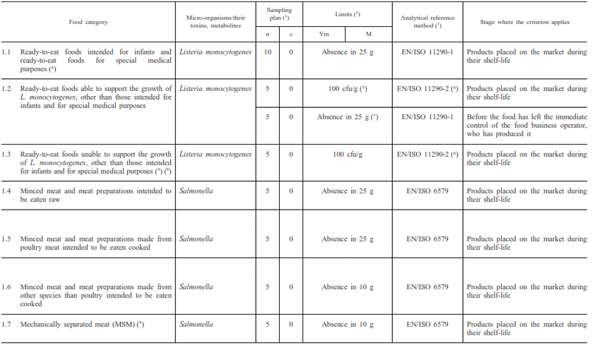
Food Safety Criteria
⁵ applies if FBO can guarantee 100cfu/g will not be exceeded throughout shelf life
⁷ applies if it cannot be guaranteed 100cfu/g will not be exceeded throughout shelf life

Slide 42
Microbiological Criteria of Foodstuffs
  FBO must take measures as part of HACCP together with implementation of good hygiene practice to ensure:
    Process hygiene criteria met
    Food safety criteria met
      Under reasonably foreseeable conditions of:
        Distribution
        Storage and
        Use
  As necessary “conduct studies” in Annex II

Slide 43
Food Standards
Contaminants
Pesticides
Additives

Slide 44
Principle 1: In practice
Undertake observations of process
  To be confident that steps correctly identified i.e typical process
  To identify any other sources of contaminants

Slide 45
Principle 1: In practice
Take measurements
  Product temperatures
  Time / temperature combinations
  pH of products
  a_{w} of products
  Microbiological samples
Purpose:
  Gather as much information about:
    Product
    Process

Slide 46
Principle 1: In practice
Evaluation of hazards
    Hazards quantified in terms of:
      Severity
      Likely occurrence
    Need to consider:
      Long term/ short term effects of exposure to hazard
    Should document discussions and conclusions for future reference
    Production of ‘short list’

Slide 47
Principle 1: In practice
All significant hazards should have been identified
Controls identified for each of these hazards

Slide 48
Principle 2
Determine Critical Control Points (CCPs)
  CCP = Step where
    control can be applied and is
    Essential to prevent, eliminate or reduce hazard to an acceptable level.
  Correct identification of CCPs essential

Slide 49
Principle 2
When determining CCPs, need to consider:
  Identified Hazards and Likely occurrence
  Processes that the food will be subjected to
  Intended use of product
Correct determination is vital
Logical approach required:
  Decision trees often used (but not essential)

Slide 50
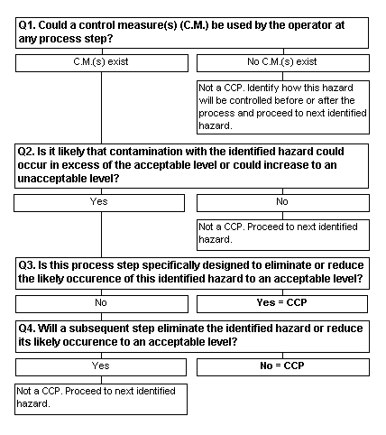

Slide 51
Principle 3
Establish Critical Limits
  Max/min value at which parameter must be controlled at CCP to control hazard.
  Critical limits can be based on:
    pH
    Salt content
    aw
    Temperature
    Time etc

Slide 52
Principle 4
Establish Monitoring Procedures
  Planned sequence of:
    Observations
    Measurements
Effective monitoring involves trend analysis
  Intervention before loss of control occurs
Loss of control at CCP = Imminent Risk

Slide 53
Principle 4
Monitoring of controls by food business operator:
  Only required at critical points
  Frequency depends on:
    Nature of product ie uniform size
    Nature of process ie automated/manual
    Nature of production ie batch size
    History of previous checks

Slide 54
Principle 4
Monitoring may include:
  Temperature checks
  a_{w} checks
  Visual checks
  Timing of process
  pH checks
  Gas monitoring (MAP)
  Chemical analysis

Slide 55
Principle 4
Microbiological examination
  Seldom effective form of monitoring
  Most effective as verification tool
Chemical analysis:
  Better to measure conditions rather than contaminants
  Rapid tests may be useful

Slide 56
Principle 5
Establish Corrective Actions
  Essential when deviation from critical limits occurs
HACCP plan should identify:
  Action required when deviation occurs
    Including investigation of cause
  Who is responsible for implementing corrective action
  What records should be made

Slide 57
Principle 5
Some corrective actions are specified in pre-requisites i.e:
  Product withdrawal
    NB. requirement for FBO to inform competent authority if unsafe food has left their control. Article 19 178/2002

Slide 58
Principle 5
Effective corrective action involves:
  Investigation of cause and correction of non-compliance
  Identify and retrieve affected product
  Record the above

Slide 59
Principle 6
Establish Verification Procedures
Check that HACCP is fit for purpose
Validation
  Ensure that all controls are scientifically sound
Calibration details
Independent verification useful
Additional verification (Review) required:
  For new products
  where new hazards identified

Slide 60
Principle 7
Establish Documentation
Should include:
  Summary of hazard analysis
  Rationale in hazard identification
  HACCP team/responsibilities
  Description of food, distribution etc
  Verified flow diagram
  HACCP plan diagram
Purpose of documentation
  To ensure effective implementation

Slide 61
Codex seven principles
Summary
Conduct a Hazard Analysis
Determine the Critical Control Points
Establish Critical Limits
Establish monitoring procedures
Establish corrective actions
Establish verification procedures
Establish record keeping and documentation

Slide 62
Workshop 1
Consider a fishmonger smoking fish

Slide 63
Hot smoked Fish
Curing fish by smoking at a temperature of 70-80°C to cook the flesh;
  hot smoked fish products do not require further cooking before consumption
Method:
  Washing/filleting
  Brining
  Smoking

Slide 64
Hot Smoking: Brining
Place fish fillets into brining tank

Slide 65
Hot Smoking: Heating
Fillets placed on racks in a kiln
    Face-on to smoke flow
Smoke generated by sawdust
Processing often in three stages:
  Drying (ie 30°C for 30 mins)
  Partial cook (ie 50°C 30-45 mins)
  Cook (ie 80°C for 30 mins)

Slide 66
Hot Smoking : Cooling
Cooled to chill temperatures quickly

Slide 67
Pre-requisites
What steps should the FBO take prior to embarking on the HACCP?

Slide 68
Hot smoked Vac packed fish
What are the significant micro hazards?

Slide 69
Hot smoked vac packed fish
What are the CCPs?

Slide 70
Hot smoked vac packed fish
What are the critical limits?

Slide 71
Hot smoked vac packed fish
What monitoring would you expect?

Slide 72
Hot smoked vac packed fish
What corrective actions are reasonable?

Slide 73
Hot smoked vac packed fish
What validation/verification would you expect?

Slide 74
Hot smoked vac packed fish
What documentation would you expect?

Slide 75
Systems based on HACCP Principles

Slide 76
Legislative framework
  Article 5 Regulation (EC) 852/2004
    ‘Food business operators shall put in place implement and maintain a permanent procedure or procedures based on the HACCP principles.’

Slide 77
HACCP Principles
Article 5(2) 852/2004
(a) Identifying any hazards that must be prevented, eliminated or reduced to acceptable levels;
(b) Identifying the critical control points at the step or steps at which control is essential to prevent or eliminate a hazard or to reduce it to acceptable levels;
(c) Establishing critical limits at critical control points which separate acceptability from unacceptability for the prevention, elimination or reduction of identified hazards;
(d) Establishing and implementing effective monitoring procedures at critical control points;
(e) Establishing corrective actions when monitoring indicates that a critical control point is not under control;
(f) Establishing procedures, which shall be carried out regularly, to verify that the measures outlined in subparagraphs (a) to (e) are working effectively; and
(g) Establishing documents and records commensurate with the nature and size of the food business to demonstrate the effective application of the measures outlined in subparagraphs (a) to (f).

Slide 78
Application of Article 5
Recital 15 852/2004
“HACCP requirements should take account of the principles
contained in the Codex Alimentarius.
They should provide
sufficient flexibility to be applicable in all situations, including in small businesses.
In particular,
it is necessary to recognise that, in certain food businesses, it is not possible to identify critical control points and that, in some cases, good hygienic practices can replace the monitoring of critical control points.
Similarly, the requirement of establishing ‘critical limits’ does not imply that it is necessary to fix a numerical limit in every case.
In addition, the requirement of retaining documents needs to be flexible in order to avoid undue burdens for very small businesses.”

Slide 79
Flexibility
‘The seven HACCP principles are a practical model for identifying and controlling significant hazards on a permanent basis.
This implies that where that objective can be achieved by equivalent means that substitute in a simplified but effective way the seven principles, it must be considered that the obligation laid down in Article 5, paragraph 1 of Regulation (EC) No 852/2004 is fulfilled.’

Slide 80
Flexibility
‘In certain cases, in particular in food businesses where there is no preparation, manufacturing or processing of food, it may seem that all hazards can be controlled through the implementation of the prerequisite requirements.
“In these cases it can be considered that the first step of the HACCP procedure (hazard analysis) has been performed and that there is no further need to develop and implement the other HACCP principles.’
EU Commission Guidance

Slide 81
Examples from the guidance may include:
Marquees, market stalls and mobile sales vehicles
Establishments mainly serving beverages (bars, coffee shops, etc)
Small retail shops (such as grocery shops)
Transport and storage of pre-packed food or non perishable food,
  where there is usually no preparation of food

Slide 82
Flexibility
“It is clear, however, that, where food safety so requires, it must be ensured that the necessary monitoring and verification (and possibly record keeping) are carried out, for example where the cold chain must be maintained”
EU Commission Guidance

Slide 83
Flexibility
No requirement for 7 principles of HACCP
Low risk businesses:
  Prerequisites may be sufficient
  No documentation necessarily required
Flexibility applies to all businesses

Slide 84
Flexibility
See Food Law Practice Guidance
  5.3.1.2

Slide 85
Implementation of HACCP
June 2015

Slide 86
Implementation of HACCP
“The Commission has just published a report on the state of implementation of HACCP in the EU and areas for improvement.
Procedures based on Hazard Analysis and Critical Control Points (HACCP) principles are mandatory for most business operators placing food or feed on the EU market. They are essential to put in place, implement and maintain a food safety management system, protecting consumers from hazards.”

Slide 87
Some of the findings:
“In all Member States there is a reasonable level of implementation of HACCP-based procedures”
“Some of the core concepts are not always understood, particularly by small FBOs, and are not applied in a consistent manner”
“Flexibility is the least understood HACCP concept and is inconsistently applied and evaluated”

Slide 88
Prerequisites and HACCP
Widespread lack of understanding of the difference between prerequisites and HACCP
  i.e. HACCP implemented, without prerequisites being in place
    then setting Critical Control Points (CCPs) for hazards which should be controlled through prerequisites
  Concern re. incorrect use of CODEX decision tree = prerequisite being categorised as CCP

Slide 89
Implementation of certain HACCP principles
Concern in the implementation of HACCP principles relating to “Hazard analysis”, setting and monitoring of CCPs and “verification”
  resulting in
    HACCP plans not correctly addressing relevant hazards
    Too many CCPs and inappropriate Critical Limits
    Unnecessary multiplication of CCPs
      leading to reduced safety levels and extra burdens with no extra benefits

Slide 90
Flexibility
Wide range of interpretation as to what constitutes flexibility
Uneven application in some Member States

Slide 91
Official Controls
Generally risk-based systems of official assessment of HACCP based procedures in place
Wide variation in the approach to controls
  frequency and content
Lack of clear national policies for flexible implementation and different approaches and interpretation resulting in not consistently applied

Slide 92
Administrative Burden
To reduce unnecessary admin burden, further clarity to FBOs on record keeping requirements
  Consideration of prerequisites and flexible implementation

Slide 93
Workshop 2
    Review some examples of what we would expect to see in the following examples, considering
      ‘Food business operators shall put in place implement and maintain a permanent procedure or procedures based on the HACCP
      principles.’
      For each example:
        Consider the HACCP
        Consider Flexibility (and if applied, what pre-requisites you would want to see in place)

Slide 94
Example 1
Small retailer selling mainly ambient goods
    Also has a small chiller display unit selling refrigerated products not produced on site

Slide 95
Example 2
Restaurant
  Small team of staff preparing and producing up to 150 covers of home-made dishes per day

Slide 96
Example 3
Retail Butcher’s shop
  Preparing, producing and selling raw and cooked meats, including vac-packing of the products on site

Slide 97
Example 4
Small Bed and Breakfast
  Prepares maximum of two cooked breakfasts a day

Slide 98
Example 5
Manufacturer of a variety of cheese products distributed throughout the UK

Slide 99
Audit of HACCP Systems

Slide 100
Audit of HACCP Systems: Overview
‘audit’
“a systematic and independent examination to determine whether activities and related results comply with planned arrangements and whether these arrangements are implemented effectively and are suitable to achieve objectives”
  Regulation (EC) 882/2004

Slide 101
Role of Local Authorities

Slide 102
Role of Local Authorities
“The primary reason for assessing HACCP is to establish whether the food business has the
ability to consistently manufacture and/or distribute safe food,
i.e. to ascertain that the HACCP system is effective.”
World Health Organisation

Slide 103
Role of Local Authorities
Assess the hazards posed by the activities of the business, the food business operator’s understanding of those hazards, and the application of appropriate controls; having regard to the nature and size of the business
Assess and verify appropriate procedures based on HACCP principles appropriate to the nature and size of the business, confirming that controls are in place and operating effectively and that appropriate corrective action is taken when necessary;
Establish whether food is being handled and produced hygienically, is safe to eat, and that relevant temperature controls are being observed;
Food Law Code of Practice 5.2.2.2

Slide 104
Role of Local Authorities
Officers should:
  Consider the nature of the business
  Identify the nature of the HACCP system required
  Verify the:
    Scope of the system;
    Training and awareness of staff
    Adequacy and validity of the system;
    Implementation of the system;
    Nature and adequacy of documentation.
  Identify and take steps to rectify legal contraventions.
  Provide guidance and advice.

Slide 105
Pennington recommendations
Inspection of HACCP plans
  must be audit based
“Red flagging” of concerns
Evidence based decisions
Discussion with staff should be standard

Slide 106
Evidence based decisions
Hierarchy of evidence:
  Verbal assurances
  Documentary evidence
  Observation by officers

Slide 107
Approach to audit

Slide 108
Audit: Key stages
1
Preparation
2
3
Audit
4
Feedback
5
Report/file
Preliminary assessment

Slide 109
Preparation
1
Preparation
2
Preliminary assessment
3
Audit
4
Feedback
5
Report/file
Consider:
  Previous
    Inspection reports
    HACCP plans
    Complaints
    Sampling results
    Enforcement
  National Companies :
    Primary Authority
  General information
  Relevant Industry Guides/ CoPs

Slide 110
Introduction
Quick “Look see”
  Identify processes, activities, obvious failings
  Initial assessment of risk
  Verify nature/existence of HACCP
1
Preparation
2
3
Audit
4
Feedback
5
Report/file
Preliminary assessment

Slide 111
Preliminary assessment
Produce sketch plans to show product flow.
    Identify possible Hot spots of cross contamination
Encourage business to do same:
“Where in a butcher’s premises ready to eat cooked meats are produced ..it is essential that the processes involved are separated from the raw meat processes so that cross-contamination between cooked and raw cannot happen.
Barrs had never had a diagram showing these.
If they had drawn one it would have been obvious straightaway that there was a risk of cross-contamination” Graham Cox QC

Slide 112
Audit
1
Preparation
2
3
Audit
4
Feedback
5
Report/file
Preliminary assessment
Systematic verification of management arrangements.
Depends on nature of HACCP

Slide 113
Feedback
1
Preparation
2
3
Audit
4
Feedback
5
Report/file
Preliminary assessment
Key points
  Clarification
  Verification
Record made of any verbal feedback

Slide 114
Report/file
1
Preparation
2
3
Audit
4
Feedback
5
Report/file
Preliminary assessment
Record matters:
  “Verified”
  “Not verified”
Differentiate
  Legal
  Recommendations
  Priorities
Ensure
  Pro-formas fully completed
  Additional notes as required

Slide 115
Audit of Codex HACCP Systems

Slide 116
Audit of Codex HACCP Systems
Most likely found in food manufacturers
Remember:
  Codex HACCP
    not legal requirement, but;
    Will satisfy legal obligations
Purpose of audit
  Identify failings in legal obligations
  Comment on “technical” non-compliances
    Where Codex requirements not met but legal compliance achieved

Slide 117
Audit of Codex HACCP Systems
Two stage approach:
  Assessment of legal compliance
  Assessment of Codex compliance

Slide 118
Audit of Codex HACCP Systems
Assessment of legal compliance should include reference to Article 5(2) 852/2004:
  Have all hazards that must be prevented, eliminated or reduced to acceptable levels been identified?
  Have all critical control points at the step(s) at which control is essential to prevent or eliminate a hazard or to reduce it to acceptable levels been identified?
  Have critical limits been established at critical control points?

Slide 119
Audit of Codex HACCP Systems
Assessment of legal compliance
  Have monitoring procedures been established at critical points? Are these effective?
  Have corrective actions been established where monitoring indicates that a critical control point is not under control?
  Are there procedures to verify that the above measures are working effectively? Have these been carried out regularly?
  Are there documents and records commensurate with the nature and size of the food business to demonstrate the effective application of the above measures?

Slide 120
Audit of Codex HACCP Systems
Assessment of legal compliance
Remember:
  Logical & systematic approach
  Evidence based
  Discussions with staff vital
  Full records made
  Only rely on verified information

Slide 121
Audit of Codex HACCP Systems
Assessment of Codex requirements
  Audit against Codex requirements useful:
    To gain confidence in system
    Assess likelihood of successful implementation.
    To identify possible improvements.
  Where “technical” deficiencies in system identified:
    Recommendations made to business.

Slide 122
Exercise
Consider the auditors’ observations and separate them into:
  Legal requirements
  Technical breaches.

Slide 123
Exercise
“The PFD had not been verified by the HACCP team”
“The HACCP team did not include any representatives from the processing department”
“The use of reworked foods was not included in the HACCP plan”
“A decision tree was not used to identify CCPs.”
“There was no evidence that the identified critical limits were adequate to control CCP 1”
“None of the production staff had received training in the seven principles of HACCP”
“No records of the corrective actions taken following failures at critical control points were being maintained”
“HACCP records were only being retained for a period equivalent to the shelf life of products”
“No microbiological sampling was being undertaken”

Slide 124
Workshop
Case Study 1
  Consider a manufacturer of apple juice

Slide 125
Apple juice – Process steps
Receipt of apples
Sorting
Washing
Storage
Pressing of apples
Pasteurisation
Packing

Slide 126
Receipt of apples

Slide 127
Sorting of apples

Slide 128
Washing of apples

Slide 129
Storage

Slide 130
Pressing

Slide 131
Pasteurisation

Slide 132
Packing

Slide 133
Audit of Codex HACCP
Pre Visit Questionnaire
Prior to audit
Review of Documentation
Opening meeting
Verification of process flow diagram
On site audit
On site Documentation review
Verification of HACCP plan implementation
Closing meeting
Report

Slide 134
Assessment of pre-visit documentation
Useful to use a checklist to verify:
  Methodology
  Scope of HACCP
  Correct identification of CCPs
  Appropriate Critical Limits
  Nature of Monitoring
  How system verified
  Format of documentation

Slide 135
Example: HACCP Documentation Assessment Checklist
Source: “Development of methods for standardised HACCP assessment”
Wallace. C and Powell, S. British Food Journal, Vol 107, No 10, 2005 pp 723-742
Subjective tool which can be useful to use
Two elements
  Desk Top Assessment Checklist
  Verification Audit Checklist

Slide 136
Desk Top Assessment Checklist
Section 1
  Overall Assessment of HACCP Plan Documentation:
    Preliminary Steps and Documentation
    Principles 1 – 5
    Section score rating
      Poor/Fair/Good/Excellent

Slide 137
Desk Top Assessment Checklist
Section 2
  HACCP System Approach
    Notes on the HACCP system and approach taken

Slide 138
Desk Top Assessment Checklist
Section 3
  Assessment of HACCP Plan Documentation
    A) Document management
    B) Codex Preliminary Steps
        HACCP Team Members
        Product Description
        Terms of reference/scope
        4) & 5) Process Flow Diagram

Slide 139
Desk Top Assessment Checklist
    C) Application of HACCP Principles
    Hazard Analysis (Principle 1)
    Determination of CCPS (Principle 2)
    Critical Limits (Principle 3)
    Monitoring Procedures (Principle 4)
    Corrective Action (Principle 5)

Slide 140
HACCP Verification Audit Checklist
Once Desktop completed, verification checklist is followed whilst on-site conducting the audit
Section 1
  Overall Assessment of HACCP Plan(s)
Section 2
  On-Site Verification of Process Flow Diagram(s)
Section 3
  HACCP Implementation
Section 4
  HACCP Maintenance Procedures

Slide 141
Workshop
Review of Case study 2
    Application of HACCP Principles
    Hazard Analysis (Principle 1)
    Determination of CCPS (Principle 2)
    Critical Limits (Principle 3)
    Monitoring Procedures (Principle 4)
    Corrective Action (Principle 5)

Slide 142
Review on Site
Principle 6 Verification and
Principle 7 Documentation

Slide 143
Advantages of checklists
Function as an aide-memoire;
Help maintain the focus and objectivity of the assessment;
Act as a record of the assessment itself;
Help ensure the completeness of the assessment;
Useful tool in ensuring consistency of approach between different assessors;
Ensure transparency of the assessment process; and engender confidence in the assessment process by all concerned.
Source World Health Organisation

Slide 144
Disadvantages of checklists
Improper design
  may include unnecessary or irrelevant items, or may omit critical items;
May restrict the initiative and judgment of the assessor and discourage critical evaluation;
Important that the use of a checklist does not evolve into a simple “tick-box” approach
  ie: no critical evaluation.
Source World Health Organisation

Slide 145
Examples where/how you can use the checklist

Slide 146
Audit of systems based on HACCP principles

Slide 147
SFBB
Validated by FSA
Implemented by business
  Compliance
Consider
  Scope of SFBB
  Reliable implementation

Slide 148
SFBB Evaluation
Are there documented methods for the 4 C’s?
Selection and adaptation to ensure procedures in place for significant hazards?
Are the procedures critical to food safety?
Are all the safe methods relevant to the business?
Are there any significant areas of the business not covered by SFBB?

Slide 149
SFBB Evaluation
Do the safe methods reflect actual practice?
Consider the safe method
  Observe
  Question
  Evaluate
Is the safe method critical to food safety?

Slide 150
Assessment of compliance with Article 5
Not all of SFBB required in law:
  Suppliers list
  Staff training record
  Cleaning schedule
  Contacts list
Some elements are essential:
  Safe methods
Can use checklist to quantify compliance.

Slide 151
SFBB Checklist
FSA SFBB – Progress Evaluation Form
  Version 2 October 2006

Slide 152

Assessment of “Home made” HACCP systems

Slide 153
Home made systems
Key issues
  Validation
    System based on science
  Scope
  Verification that system working in practice
  Review

Slide 154

Validation of home made systems
A restaurant/chain wants to supply its customers “rare burgers”
  What steps should they take to validate their HACCP?

Slide 155

Enforcement of Article 5

Slide 156

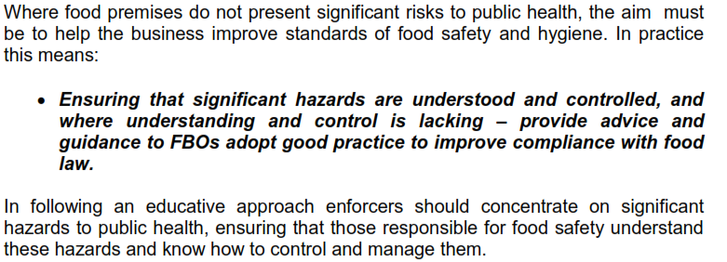
Approach to enforcement
Food Law Practice Guidance

Slide 157
Food Law Practice Guidance
5.3.1.2
“For enforcement, in practice, compliance means:
  obtaining assurance that the person responsible for food safety understands significant hazards
    and has them under control
  seeing
    that there are some written procedures that demonstrate how the business controls these hazards at all times;
    some evidence that these procedures are followed, and that they are reviewed and kept up to date.”

Slide 158
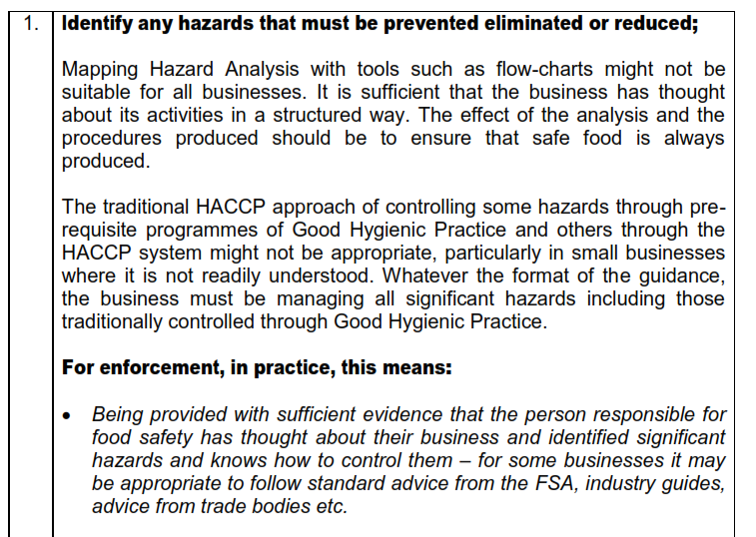
Approach to enforcement
See table in Food Law Practice Guidance
  5.3.1.2

Slide 159
Enforcement Options
Hygiene Improvement Notice
Hygiene Emergency Prohibition
Remedial Action Notice
Detention Notice
Seizure
Prosecution

Slide 160
Hygiene Improvement Notice

Slide 161
Hygiene Emergency Prohibition

Slide 162
Remedial Action Notice

Slide 163
Detention Notice

Slide 164
Seizure

Slide 165
Prosecution

Slide 166
Food Law Code of Practice
Statement of Competence No.4
6th April 2016
Inspection of Food Establishments
  4.1 Comprehensive understanding and knowledge of HACCP-based procedures. Has the ability to apply that knowledge taking account of flexibility principles contained within Article 5 of Regulation (EC) no. 852/2004

Slide 167

Summary

Slide 168
Codex Principles
Pre-requisites and their importance
Systems based on HACCP and flexibility
Auditing - approach, assess, verification and checklist tool
Systems based on HACCP
Home-made systems
Enforcement options

