Slide 1

HACCP in Feed Establishments

Slide 2
Aims
To provide delegates with an overview of HACCP principles and their application to the feed industry

Slide 3
Objectives
This course seeks to:
  Review main principles of HACCP
  Consider role of pre-requisite programmes in HACCP systems
  Examine the main processes in production of HACCP systems
  Provide delegates with practical tips on assessment of HACCP systems

Slide 4
Programme
9.30 Registration
10.00 Introduction
    HACCP principles
    Legal framework
    Pre-requisties
11.15 Coffee
    Hazard analysis, critical control point identification
monitoring, establishing critical control points
  - Corrective actions
  - Verification of HACCP systems
  - Documentation
13.00 Lunch
    Assessment of HACCP systems
    Workshop
14.45 Coffee
    Workshop
16.00 Summary/Questions
Notes:
Breaks

Slide 5
Introduction
Notes:
Housekeeping
Fire Exits
Name, Experience with HACCP

Slide 6
HACCP
HACCP
  ‘Hazard Analysis Critical Control Point’
Food/feed safety management system
Developed for US space programme
Involves analysis & control of hazards:
  Biological
  Physical
  Chemical
Notes:
HACCP is an acronym for Hazard Analysis Critical Control Point.
It’s a simple risk assessment tool used to ensure Food and animal Feed is safe. The HACCP approach is science based and systematic, it identifies specific hazards and and measures for their control to ensure the safety of feed. HACCP is a tool for establishing a control system to focus on prevention rather than relying mainly on end-product testing.
It was developed by NASA in the 1960s who were looking at the risk of food poisoning in the first space missions and the risk of astronauts filling their space suits not in a good way. They went to the pilsbury dough company to come up with a risk management process to identify Hazards and controls and to identify the critical elements so that at least these were covered.
The system was adopted by codex (UN and WHO committee which sets standards). In 1968 codex adopted HACCP principles in the annex to their food hygiene standard published in 1969. Canada ran with this early, the EU adopted its principles in 1996 and the USA adopted them in 2016.
The Pillsbury Company working with NASA Collaborative effort to develop safe food for Astronauts involved in the United States space programme Prevent illness that might cause aborted mission. Wanted close to 100% assurance that food was not contaminated
We are looking at Hazards which is something with the potential to cause harm to animals, or to human health through consuming the food produced from animals.
Could be biological (salmonella), physical (glass, plastic, metal) or chemical (contaminants – heavy metals, mycotoxins)
We are looking at safety not just forgetting your keys and not getting in the building. HACCP text books only have a small amount on HACCP, the rest makes it out to be a complex system.

Slide 7
Principles of HACCP
Codex alimentarius
  HACCP System and Guidelines for its Application
    CAC/RCP-1 (1969), Rev 4 (2003)
Internationally recognised system
  Not legal requirement in EU
  Compliance with Codex HACCP will satisfy legal obligations (if fully implemented)
Notes:
Feed Businesses need an effective and implemented HACCP plan.
Good questions included does it work in practice by people on the ground?
Best ones have coffee stains and are hand written and relate to the business and are actually used not a template downloaded from the internet.
Codex alimentarius HACCP is non statutory and countries look to it when considering legislation on food or feed control. It is an international reference point implemented into EU law in 2006 almost in its entirety.
Its important to stress the EU only requires that businesses have a system based on HACCP principles but businesses may choose to implement a full Codex HACCP system, especially if they intend to export their own products to ensure they can send products anywhere in the world. Trade bodies and membership schemes may also insist on requirements based on Codex which may go beyond the legislative requirements.

Slide 8
Codex seven principles
Conduct a Hazard Analysis
Determine the Critical Control Points
Establish Critical Limits
Establish monitoring procedures
Establish corrective actions
Establish verification procedures
Establish record keeping and documentation
Notes:
Codex has 7 principles which are quite involved.
Identification of Hazards – long list of hazards, what actually could go wrong and the harm (reasonably likely to occur). Evaluate the Hazards to a short list looking at significant Hazards then identify controls for those significant Hazards.
Determine CCP – Develop a process chart (Flow diagram) and identify which points are critical to control Hazards. Only a few points are critical. You can use a decision tree to determine the critical ones.
Establish Limits which are critical. These are at the critical control points. E.g. Aflatoxin - CCP based on factors relating to this i.e. moisture. These need to be observable and measureable. E.g. Observe it is boiling or measure it is at 100*C.
Monitoring at CCP to ensure that critical limit is not being exceeded. This should be a real time activity to ensure this is met.
If set level is monitored and failed corrective action is needed to stop the problem.
Verification procedures. This is important on inspections. All limits, monitoring etc needs to work and be verified – based on science and fact – not a guess. Challenge businesses on this on inspection – causes headaches for them as difficult to prove some things. Usually will be references published to help with this i.e. someone else has done the research and published the information (i.e. IFR do validation studies). For more novel production processes causes issues as will need to do their own research to validate their chosen methods work. Then they need to show that it all works in practice. E.g. does the equipment work in the way is says it does – if CCP says will read down to a certain temperature, but the equipment doesn’t read down that far then not right. Also – are they doing it in practice? E.g. – start sampling to show it works but need to keep reviewing it – e.g. yearly, change of equipment/supplier/customers etc – trigger a re-view of HACCP system. If don’t get hazards right then the rest of the system is wrong – if they don’t understand hazard could be an issue – can business explain the hazards to you?
All steps properly documented – huge amount of documents – e.g. on why rejected some hazards, why they choose those controls etc. Records of monitoring.

Slide 9
Legislative framework
Feed Hygiene
  Article 6 of Regulation 183/2005
  ‘Feed business operators carrying out operations other than those referred to in Article 5(1) shall put in place, implement and maintain, a permanent written procedure or procedures based on the HACCP principles.’
Notes:
The codex 7 principles or full codex system exceeds what is required in EU law.
Regulation (EC) 183/2005 only requires a system “based” on HACCP principles – so doesn’t have to be the full codex system.
The word “based on” is a big word – allows lots of flexibility for big/small businesses depending on activities
If they have the full codex system then they will be complying with this requirement.
Similar requirements in Food Law (Art 5 of 852/2004).

Slide 10
Exempt from HACCP requirements
Primary production and
  (a) transport, storage and handling of primary products at the place of production;
  (b) transport operations to deliver primary products from the place of production to an establishment;
  (c) mixing of feed for the exclusive requirements of their own holdings without using additives or premixtures of additives with the exception of silage additives.
Notes:
Which feed businesses don’t need HACCP?
Article 6(1) of 183/2005 provides that those feed businesses referred to in Art 5(1) don’t require a system based on HACCP principles. These include the following….
“Primary Production” – stops being primary product when processed (cut off point) – definition of process under 852/2004
These businesses will still need to consider Annex I of 183/2005 though!
In food primary production also doesn’t require a HACCP

Slide 11
HACCP principles
Article 6(2) 183/2005
(a) Identifying any hazards that must be prevented, eliminated or reduced to acceptable levels;
(b) Identifying the critical control points at the step or steps at which control is essential to prevent or eliminate a hazard or to reduce it to acceptable levels;
(c) Establishing critical limits at critical control points which separate acceptability from unacceptability for the prevention, elimination or reduction of identified hazards;
(d) Establishing and implementing effective monitoring procedures at critical control points;
(e) Establishing corrective actions when monitoring indicates that a critical control point is not under control;
(f) Establishing procedures, which shall be carried out regularly, to verify that the measures outlined in subparagraphs (a) to (e) are working effectively. Verification procedures shall be carried out regularly; and
(g) Establishing documents and records commensurate with the nature and size of the food business to demonstrate the effective application of the measures outlined in subparagraphs (a) to (f).
Notes:
These are the HACCP principles referred to in 183/2005 – the principles that businesses will need a system based on
“Prevented, eliminated or reduced to acceptable levels” – codex language – includes reduction to an acceptable level, e.g. mycotoxins. Look to prevent it but in reality looking at cereals which will contain them, so it is making sure your system is set up to reduce them to an acceptable level – i.e. the level laid down in law in the case of mycotoxins.
“Limits and monitoring” only required a CCP’s – but businesses can monitor what they like, they may do more than required
“CCP’s” – critical points in ensuring that feed is safe
“Documentation” – flexible in nature depending on size of business and what they do.

Slide 12
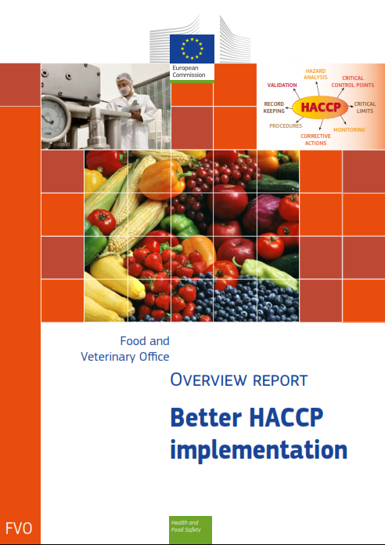
Implementation of HACCP
Key issues
  Flexibility
    Misunderstood
    Inconsistently applied
    Especially in feed sector
  Core concepts not understood
Notes:
Report from FVO – published in July 15. Following a request form the EU commission for them to look at HACCP implementation in food and feed businesses and how it is being assessed by member states – their overall assessment was that it wasn’t great!
Some of the main findings were that, “flexibility is the least understood HACCP concept and is inconsistently applied and evaluated. This is a particular issue in the feed sector”.
In relation to flexibility the FVO commented – under the heading of “administrative burdens” on businesses – “flexible implementation of HACCP is intended to eliminate the burden of unnecessary record keeping. However, difficulties are experienced by small businesses with documentation and record keeping, which, in some cases, are viewed as excessive. A lack of understanding of flexibility related in small businesses maintaining unnecessary documentation.”
The FVO highlighted Examples of Good practice in the document and in terms of flexibility highlighted Germanies approach to flexibility in both feed and food businesses. In relation to feed they broke it down into 4 categories.
Category 1: The feed business operators do not carry out manufacturing or processing activities e.g. traders without a warehouse, third country representatives, transporters, warehouses storing or transporting only packed feed. These enterprises should meet the requirements of Good Practices, in particular, Annex II of Regulation (EC) No 183/2005. The potential risks and their controls have to be described. Documentation requirement is a written declaration by the operator on the evaluation and assessment of processes in the establishment relating to possible risks.
Category 2: Enterprises such as compound feed producers including mobile milling and mixing facilities, compound feed producers without any feed additives, premixes or processed animal proteins, farmers using additives but only on their own premises. These enterprises should develop a simple system based on HACCP principles (Article 6 Regulation (EC) No 183/2005) meeting and respecting the requirements of sector specific guides on good practices. Documentation requirement is to implement sector specific guides on GHP. If such a guide is not available the enterprises have to implement specific good practices for the establishment.
Category 3: These are complex enterprises such as drying facilities with direct drying, producers of compound feed containing additives, premixes or processed animal proteins, producers of feed additives or premixes without approval requirements. These enterprises should develop comprehensive and establishment specific HACCP systems, considering the requirements of the sector specific HACCP procedures relating to technologies and processes
used in the establishment. Documentation requirements are the description and schematic representation of the establishment specific activity profile including hazard analyses, proof of implementation of sector specific guides, and proof of homogeneity.
Category 4: These are critical enterprises such as mobile milling and mixing facilities with the possibility to produce medicated feed, producers of compound feed containing pre-mixes, coccidiostatics and histomonostatics, producers of feed additives or pre-mixes with approval requirements. These enterprises should develop a comprehensive and establishment specific HACCP system, relating to individual technologies and processes used in the establishment.
Documentation requirements are the description and schematic representation of the establishment specific activity profile including hazard analyses, proof of implementation of an establishment specific HACCP system, and proof of homogeneity testing and crosscontamination testing.

Slide 13
Flexibility
Recital 15 183/2005
‘HACCP principles in feed production should take into account the principles contained in Codex Alimentarius, but should allow sufficient flexibility in all situations.’
‘In certain feed business, it is not possible to identify critical control points and, in some cases, good practices can replace the monitoring of critical control points.’
‘Similarly, the requirement to establish ‘critical limits’, as set out in the Codex Alimentarius, does not require a numerical limit to be fixed in every case. The requirement to retain documents as set out in the same Code needs to be flexible to avoid undue burdens for very small businesses.’
Notes:
“all situations” – everyone has access to flexibility – not just small businesses
In some feed businesses there may not be any CCP – all covered in the pre-requisites
Critical limit – observable/measurable )from Codex – visual check ok to demonstrate feed safety
Businesses can follow codex, but not suitable for all businesses, these Regulations don’t dumb down HACCP but make it suitable for all businesses, e.g. simple hazards may be controlled with good housekeeping

Slide 14
Flexibility
‘The seven HACCP principles are a practical model for identifying and controlling significant hazards on a permanent basis.
This implies that where that objective can be achieved by equivalent means that substitute in a simplified but effective way the seven principles, it must be considered that the obligation laid down in Article 5, paragraph 1 of Regulation (EC) No 852/2004 is fulfilled.’
Notes:
This is a 2006 guidance document issues by the EU commission – this is what the FVO looked at during their mission and took into account with their report – this is likely to be amended!
Says that you don’t need full HACCP for safe feed – if doing it through a simplified matter which delivers safe feed – then that is all ok. Focus is on the outcome and the procedures in place to reliably achieve that outcome.

Slide 15
Preliminaries
Notes:
*Sum up story so far!
Codex is the international reference standard – not legally required but found in large feed businesses supplying products internationally to assist with trade
Legal obligation in 183/2005 to have a system “based” on HACCP principles
BUT, flexibility is important, allowed in all circumstances – don’t forget focussing on achieving safe feed rather than the volumes of documentation they have.
Assurance schemes may go beyond legal requirements. Some assurance schemes get HACCP and will give non-conformities for having too many CCPs for example, but others wont!
If it’s a bog standard process - practically on inspection look at the hazards identified, are any missing, are they controlling them? If through pre-requisites or GMP then this may be fine
Some businesses may have no CCP’s, on inspection looking at how they arrived at this decision. They often get these decisions right but can’t explain how they got to them, which is concerning!
So before considering a HAPPC you have to look at the preliminaries…….

Slide 16
Preliminaries
Before embarking on HACCP should consider:
  Pre-requisites
Essential for successful HACCP
Provide basic environment & operating conditions
  Effective & well run company
Prerequisites based on:
  Legal requirements i.e Annex II 183/2005
  Good Manufacturing Practice
  Codex Alimentarius General Principles
Notes:
So before you even start looking on inspection at the systems and feed you should consider the bits a business should already have in place.
HACCP is a management system designed to fit within a well designed, properly run business. The business you may be inspecting may not be this!
So before looking at HACCP look at pre-requisites such as what is building like, the environment, training, cleaning etc first – as no matter how good the HACCP system is, if these aren’t thought about first then it will still fail. Think of it like the foundations of a house! Once foundations are set (i.e. everything working properly) can start to build your HACCP!
Prerequisites should be based on the legal requirements as set out in Annex II of 183/2005 – which includes – facilities and equipment, personnel, production, quality control, dioxin monitoring (added more recently), storage and transport, record keeping, complaints and product recall.
GMP – EU has produced some guides to good practice for businesses, for example, European Feed Manufacturers’ Guide (EFMC) Community guide to good practice for the EU industrial compound feed and premixture manufacturing sector for food producing animals (Version 1.2 December 2014) which has a whole section on GMP covering structure etc.
- assurance schemes standards
Codex also has some guidance on pre-requisites to consider.
Practically this may include – obtaining feed ingredients from assured suppliers, pest control and maintanance schedules etc.

Slide 17
Pre-requisites
HACCP involves:
  Review & assessment of existing pre-requisites
Any environmental hazards not controlled by pre-requisites should be included in HACCP
Notes:
1st check prerequisites – check all working properly. Look at the environment, building, ceilings, equipment, make sure stuff not falling from ceiling, metal from equipment, controlled through housekeeping arrangements.
Any environmental hazards not controlled by pre-requisites should then be included in HACCP. Examples may include transport issues both to and from business, 3rd party contractors – TSO’s taking samples may be a hazard!
Goes back to idea if you have a poor business a all singing all dancing HACCP system may not improve them. Look to train staff etc rather than manage out the hazards. Sort out the ceiling rather than manage the hazards it creates. For example, strip lightbulb, if it shatters would put glass onto feed, which is a hazard. Rather than putting a control in place, such as visual inspection of the feed in your HACCP system, as a pre-requisite place a cover over the bulb.
Or, don’t store feed next to diesel tank, place elsewhere so don’t even have to consider as a hazard in HACCP system.

Slide 18
Pre-requisites
Pre-requisite issues:
  Supplier control
  Specifications
  Storage and transport
  Equipment
  Personal hygiene
  Training
  Cleaning
  Pest control
  Product withdrawal
Notes:
Some pre-requisites to consider…..
You will need to know when looking at pre-requisites what is required by law (i.e. in Annex II of 183/2005 – see slide) and what is GMP or recommendations.
You will need to take a view on interpreting “adequate”, “necessary” as these terms used in Annex II and will need to be applied. Don’t forget though that EU law is designed to be flexible to all businesses so you may have to scale up/down these requirements accordingly.

Slide 19




Feed assurance schemes
Notes:
Assurance schemes standards may set out arrangements for pre-requisites, but these are likely to go beyond what is required in 183/2005.
Don’t forget these schemes are approved assurance schemes so members will gain earned recognition!

Slide 20
Preparing a HACCP

Slide 21
Preparing a HACCP
Integrity & effectiveness of HACCP
  relies on detailed preparation
MyHACCP (https://myhaccp.food.gov.uk/)
Notes:
A good HACCP is like decorating, its all in the preparation, if you rush the preparation stage the finished product will never be quite right!
This is all about engagement – need to manage hazards in their business, so will need to understand their business, their products, their customers to ensure this is done correctly.
A tool that may be used is MyHACCP which is an online tool provided by the FSA – its aimed at food businesses – but works just as well for feed ones too!

Slide 22
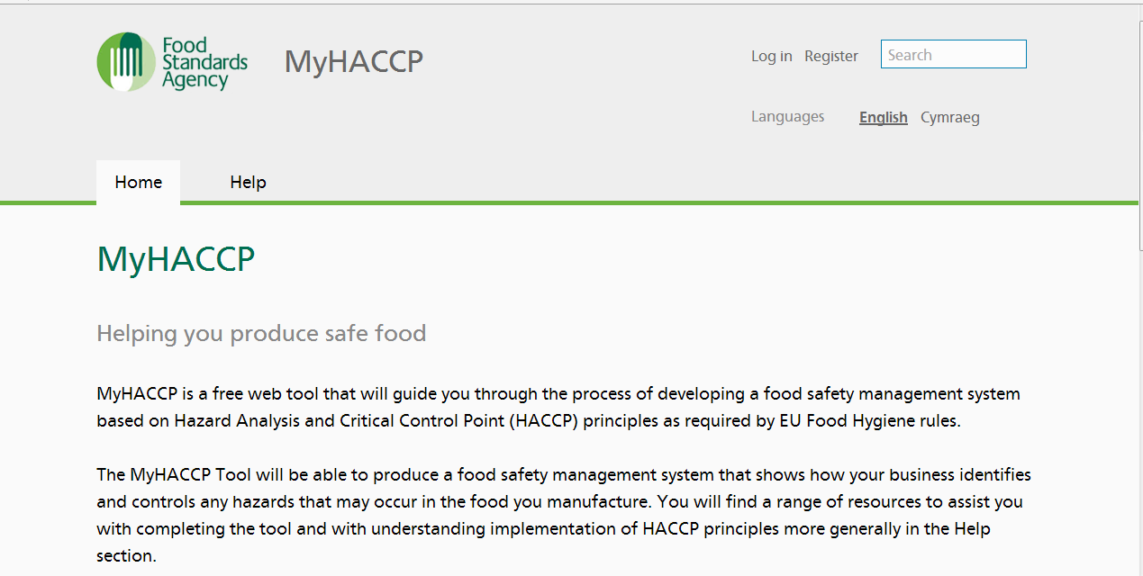
MyHACCP
https://myhaccp.food.gov.uk/
Notes:
Go through online if have Internet access.
Is in the process of being updated – so watch this space!

Slide 23
MyHACCP
Provides businesses with:
  Web tool that leads them through a HACCP study protocol
    Focus is on their products
    also considers the prerequisites
Notes:
What the system does is provide businesses with a logical approach to HACCP by asking them questions and getting them to think about each stage from what their product is, the hazards they may have, flow diagrams, HACCP team, prerequisites and then each of the 7 principles.

Slide 24
MyHACCP
Tiered guidance on:
  Preparation for a HACCP study
  Working through each of the HACCP principles
  Identification of hazards, their analysis, CCPs and control
Notes:
As they work their way through there are ? Symbols to click on to find out more information to assist them with putting the HACCP plan together. It may be a time consuming process but spending the time to get it right is essential for a HACCP system to be successful.

Slide 25
MyHACCP
External web links to relevant information
Pdf output of
  the finished HACCP study and;
  HACCP based controls.
Notes:
At the end they can print out a PDF document covering everything they have put into their system which they can save or print out as required.
As Regulators you can also create a “dummy” account and trial the system yourself, which may be useful.

Slide 26
HACCP – First Steps
Assemble HACCP Team
Describe Feed
& Distribution
Describe Intended
Use & Customers
Develop Flow Diagram
of Process
Verify the Flow Diagram
Notes:
Classic approach is going through this process – these steps are not required in law, but gives you confidence in the business and that HACCP system is accurate.
Assemble HACCP Team – relevant to small businesses as well. From the food side – Dairy Crest MD in 1980’s wanted a HACCP system. Technical manager developed HACCP in dairy – team put together from all parts of thr business so had both operational and technical experience even down to forklift drivers, so they know what actually happens on the shop floor. Shouldn’t just be the QA manager as they will know what should happens but not what does happen! If you design a HACCP system based on what should happen it may not work, especially if asking Bob to change the way he operates after doing it one way for 30 years!
Small businesses should look at the complexity of the situation – could speak to other businesses, co-operative approach, or bring in expertise form other organisations. People to help the business not do it for them! However, it may just be one person is “the team” similar to some Local Authorities these days!
Businesses should make a record who is on this team
Describe Feed & Distribution – describing the physical and chemical properties – need to understand feed and hazards likely to be present, e.g. encourage growth of moulds, need to understand this. Could take samples of feed, assess moisture, e.g. pellets likely to contain less moisture? Composition of final product needs to be understood as helps to identify hazards. Then look at how distributed – contractors? How far, local, international
Describe Intended Use and Customers – for feed type of animal fed to, customers are they farmers, retailers, wholesalers or other feed businesses
Develop Flow Diagram of Process – write out the process – best on one A4 sheet of paper – one business has 4 volumes as done by chief engineer. Flow diagram should be straightforward – starting at where in and then where out.
Verify the flow diagram – nce agreed process go round and check what happens in process as may be different. Raw milk tankers – tested by lab and put in silo. Angry drivers not wanting to wait to unload delivery to silo which may be 3-4 hours for a silo to be empty so operator not wanting the angry drivers to be angry at them found an empty silo which was the waste tank so put new milk in there. They had been using tanks being cleaned previously as well. People will do what they think is right. QA manager may not see all the hazards to important to verify the flow diagram to find out what does happen and what does not!
This is something that you can do on inspections too. One brewery had downloaded a template HACCP plan from Internet looking at waste grains. When looking at this and walking round brewery it was obvious it didn’t relate to their operations.

Slide 27
HACCP team
Responsible for undertaking HACCP
Should include representatives from all aspects of business
In large premises, could include:
  Production manager
  Process engineer
  Operator(s)
  QA/Technical manager
Notes:
Not a legal requirement – but builds confidence
It should include representative from all aspects of the business – if you find that something isn’t working in the HACCP system then this may be due to the fact they didn’t include people from all aspects of the business on the team – so could have this as a recommendation on your inspection or audit report form.
May want to include HR staff for training, cleaners etc. Maintenance team, transport team etc.
People from different shifts to keep consistency across shifts especially if working 24 hours.

Slide 28
HACCP team
In small premises
  Feed Business Operator
  Staff
Team must have access to technical information to be effective
Notes:
So in small premises may just be the FeBO – but they should have assess to technical information in order to be effective.
May need an MD or Director in order to pay for the implementation of HACCP, training, equipment etc.

Slide 29
Description of Feed
HACCP team must understand key characteristics of feed
  Chemical composition
  Physical state
  Packaging
  Shelf life
  Labelling information
Notes:
The HACCP team must be able to understand the characteristics of the feed in order for them to be able to understand the hazards, which may be due to their chemical composition (formulation, raw materials/ingredients and their origin), physical state (processing – has it been heated and/or other preservation methods), packaging and storage (moisture levels, temperature), shelf life, labelling information (e.g. storage and handling, intended species) etc.

Slide 30
Intended use
Ready to eat
  Further processing by customer
Target group:
  Feed – species of animal
Likelihood of misuse
  Temperature abuse
  Preparation of feed
Notes:
Busiensses need to understand what the feed is going to be used for, how is it to be used by their customers.
I.e. – what animals is it designed to be fed to
What foreseeable misuse could there be – i.e does it need to be stored in a particular way? Leaving feed in a car on a hot day?
May consider packaging rather than selling loose etc – to control moisture if this is an issue
An example of looking at intended use/customers from the food industry – a producer of cooked food stated on label store at 5 degrees. However, legal requirements for retailers is for fridges to be at 8 degrees and producer knew this. So should consider this in HACCP system, what would be effect of storing at 8 degrees rather than 5 etc. Does label need to be changed to reflect this etc.
Linear v Modular HACCP = if all same feed then linear HACCP so all in one
If species specific then process may be the same but contains different additives so will have the same team and the same plan but then different modules for each type of feed. All together they then product one overall modular HACCP system.

Slide 31
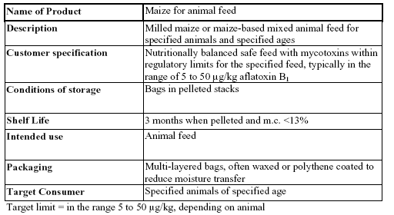
Notes:
An example of how the feed may be described in a HACCP system is……

Slide 32
Flow diagram
Include
  main steps in process
Easy to read
Concise
Notes:
Flow diagram should include steps not in great detail
It may be the “pelleting of feed” step then has a further 10 steps – this could be on another flow diagram as necessary
This is a good reference point on inspection – avoid pages and pages this document should be concise and easy to read – if you can’t understand it then it may be too complex and as a recommendation they should look at this again to simplify it.

Slide 33
Process Flow diagram (PFD)
Identifies all key stages of the feed activity
From purchase and receipt of raw materials to the supply of the finished feed
PFD should be detailed enough to identify key stages but not over complicated
Notes:
The flow diagram should identify all key stages of the activity from receipt of raw materials to finished product. It should be concise identifying all key stages but not to be over complicated.

Slide 34
Verification of flow diagram
Members of HACCP ‘walk the process’
  Verify that process flow & plan are accurate
  Check for consistency
    E.g. different shifts
  Rectify immediate problems
  Ensure consistency to aid with effective HACCP implementation
Notes:
This is literally going through the process from start to finish using the flow diagram – good to do on inspections as well as the business doing it to.
It may be that Jimmy has done something for a number of years – will he be able to change if you don’t include what he does into the plan as it currently it.
Then we have documentation of these first steps – a full codex system will require full documentation of who is on the team, qualifications, competency etc. Helps to make sure you have the right team together, covering technical and operational staff etc – so they can advise on each of the steps.
Easy to write a procedure that won’t be implemented in practice – so get everyone involved to make sure it can be implemented and is realistic. Think about the AA book of car – before you switch your engine on you should check oil levels, fluids, tyre pressures, tread depth etc, but in reality you just jump in the car and go. HACCP system is the same, if they say they are going to do A-Z steps but in reality only do A then need to consider whether they need to re-view the system, is it actually working in practice.
A HACCP system shouldn’t be about forcing people to do the gold standard – as long as what is being done is ok, then build this into the HACCP system – makes it easier to ensure it is being done in practice.

Slide 35
Codex seven principles
Conduct a Hazard Analysis
Determine the Critical Control Points
Establish Critical Limits
Establish monitoring procedures
Establish corrective actions
Establish verification procedures
Establish record keeping and documentation
Notes:
BREAK!!!
So we have had a quick look at the seven principles of HACCP and now we will go back and have a more detailed look at each of the steps and what they are all about!

Slide 36
Principle 1
Conduct a Hazard Analysis
Notes:
So, principle 1 – conduct a hazard analysis.
The first thing to do is think about what a hazard is – we have a definition on pages 39-40 – “A hazard is – a biological, chemical or physical agent in, or condition of feed with the potential to cause an adverse health effect.”
And then what a hazard analysis is – “the process of collecting and evaluating information on hazards and conditions leading to their presence to decide which are significant for feed safety and therefore should be addressed in the HACCP plan”.

Slide 37
Principle 1
Conduct a Hazard Analysis
  Identify significant hazards
    Reasonably likely to occur
    Likely to cause illness/injury if not controlled
    Hazard refers to safety not quality issues
    Correct hazard identification = essential step
  Identify appropriate control measures
Notes:
So the first step is to think about what hazards could occur, in practice this will be a long list of hazards from things like aflatoxin B1 to salmonella, heavy metals, to meteor strikes. However, for HACCP only want to consider what is likely to happen and is significant. Can quantify hazard (likelihood v severity) to decide if significant or not.
Feed business should go through this step put down how likely and severe to see whether it is significant or not. If it is significant then they will need to identify an appropriate control measure to control that hazard whether it is preventing it entirely or reducing it to acceptable limits.
E.g. – meteor strike would be pretty severe but the likelihood is minimal so overall not a significant hazard you would see in your HACCP plan. Obviously if we were in Iceland – volcanoes may be something you think could be significant!
Pre-requisite (not significant hazard) vs CCP (some significant hazards)

Slide 38
Principle 1
Notes:
What you can do is develop a method of quantifying the risk of a hazard based on their likelihood and severity.
This is a fairly straightforward way to assess risks to demonstrate if they are significant or not. A business should identify where on the chart they are using they consider them significant and where they don’t.
Liklihood on left hand side 0 – never happen, 1 – unlikely, 2 – probable, 3 – certainly will happen
Severity – 0 – no issue, 1 – not too bad, 2 – quite bad, 3 – severe
Liklihood x Severity = Consequence
For example….
Salmonella in pelleted feed stuff – micro hazard is it likely to grow in this product? HACCP team may need to get guidance on this
Metal in pellets – severity 2 – usually for foreign objects. Can cause damage but not usually deadly. Likelhood – is metal a common component then more likely
Aflatoxin growth – severity 3 possible, likelihood based on product may also be 3
HACCP team will decide at what level they consider it to be significant. For example they may say that anything below 2 x 2 they will deal with through pre-requisites, andy anything above that it significant which will go into the HACCP itself.
If it is a signigicant hazard we now need to identify how we are going to control it – what control measure can we put in place.
This scoring system is not a legal requirement – so cant make them do it, but may be a recommendation that they incorporate this type of decision making process when deciding what is a signigifcant hazard and what is not.

Slide 39
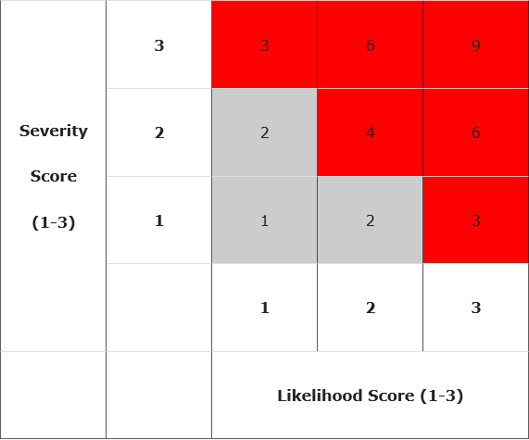
Principle 1
Notes:
From MyHACCP – how the risk assessment may then be used.

Slide 40
Principle 1: In practice
Purpose of Hazard Analysis:
  Produce list of significant hazards
    That are reasonably likely to cause harm
      If not controlled
  Hazards that are not reasonably likely to occur do not need to be considered further
Notes:
The reason we are looking at significant hazards is we want to control those that if we don’t then harm is reasonably likely to occur.
If we do this and harm still occurs then businesses are still protected in law with defences such as due diligence – took all reasonable precautions… The law accepts that stuff happens but as long as they have considered what are the significant hazards then they are protected by this defence.
For hazards which are not reasonably likely to occur then they don’t have to be considered at all or covered by pre-requisites.

Slide 41
Principle 1: In practice
Brainstorming session to identify hazards
  List out possible hazards (long list)
    Specific to grain
    Maize: susceptible to Aspergillus sp
      Aflatoxins
  Consider
    Intrinsic factors
    Extrinsic factors
Notes:
So in practice the HACCP team will brainstorm to identify hazards – all possible hazards which may be a long list.
For example if we were looking at grain such as maize then one of the hazards we may identify is aflatoxins.
For maize based feed there is an issue with aflatoxins as the maize is susceptible to this hazard so it is an issue we put on our list.
We then look at the intrinsic (what's in the feed) and extrinsic factors (outside feed – external factors) – to see what promotes or inhibits the hazard – in this case aflatoxin

Slide 42
Principle 1: In practice
Intrinsic factors of feed
  Factors that might promote/control fungal growth
    pH, aw
  Normal fungal flora of grain
Notes:
Intrinsic factors may include…..
For aflatoxins we may be looking at pH and water activity

Slide 43
Principle 1: In practice
Extrinsic –
  Temperature
  Humidity
Notes:
This could include looking at,,,,,,
In practice you are looking at how the product is stored, used, distributed.

Slide 44
Principle 1: In practice
Review process operations for hazards
  Examine each step of flow diagram
  Consider any hazards that might occur
  Consider
    Product flow
    Personnel flow
      Identify any step where contaminant
      could be introduced
Notes:
After considering the product (feed) and the hazards we can look at the process to see if any hazards are introduced here.
Examine each step of the flow diagram and consider the hazards that may occur. Things to consider are the product flow – where does it go, what happens to it any hazards i.e. carryover of additives? As well as personnel flow – who handles/deals with the feed – is there a hazard or contaminant that could be introduced?

Slide 45
Principle 1: In practice
Undertake observations of process
  To be confident that steps correctly identified i.e typical process
  To identify any other sources of contaminants
Notes:
It is always good to undertake observations of the process – go and look at the process – see if anything has been missed – as there may be hazards which you haven’t considered – milk tanker example.
This will give confidence that each of the steps have been correctly identified and may demonstrate other hazards or sources of contamination which haven’t previously been considered.

Slide 46
Principle 1: In practice
Take measurements
  Product temperatures
  Time / temperature combinations
  pH of products
  a_{w} of products
  Microbiological samples
Purpose:
  Gather as much information about:
    Product
    Process
Notes:
Advisable to make measurements of the product to help understand the feed
This will give you as much information as possible about the feed and process it undergoes.
It may be though doing this and research into the particular hazards that the business can start to identify where issues could be such as if the moisture or water activity are above a certain level issues occur, or above/below certain temperatures, so they can already start to build a picture of how the hazards need to be controlled.
This can only be done if they fully understand their product(s)

Slide 47
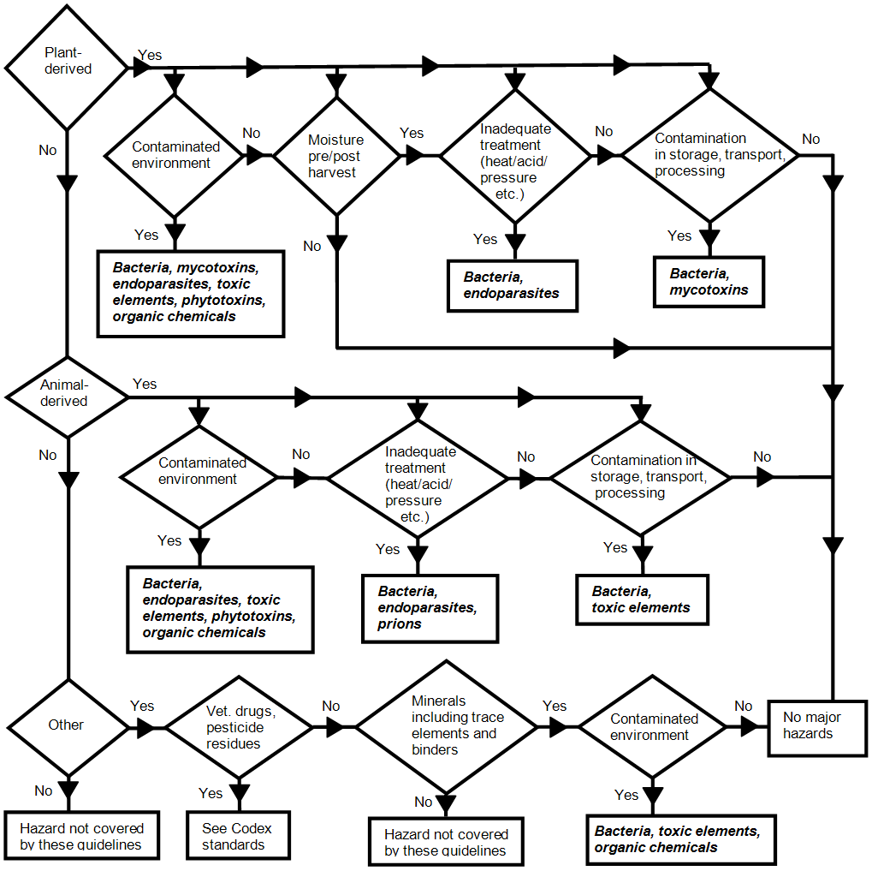
Hazard Determination Diagram
Notes:
From Codex – Draft Prioritised List of Feed Hazards – July 2011
Some businesses/Officers may use a diagram such as this useful when developing their HACCP plan to determine what the hazards may be.
Diagrams such as this may not pick up on all the issues, there could be other hazards as well which the business would need to consider – especially for food businesses supplying feed, such as packaging material getting into the feed, Animal By Products mistakenly being sent for feed, time feed being stored, will it become unsafe if stored for a week in a hot temperature etc – these are all potential hazards that could cause the feed to become unsafe.
When we have identified the hazards, we will need to know the source, cause of the hazard to see how it can be controlled – this will help with the next step of determining CCP’s.

Slide 48
Principle 1: In practice
Evaluation of hazards
    Hazards quantified in terms of:
      Severity
      Likely occurrence
    Need to consider:
      Long term/ short term effects of exposure to hazard
    Should document discussions and conclusions for future reference
    Production of ‘short list’
Notes:
After this we go through our step of evaluating all of the hazards they have identified and quantifying them using the method shown previously or other method looking at severity and likely occurrence, taking into consideration factors such as the long and short term effects of exposure to the hazard.
Any decisions and conclusions they arrive at should be documented – if it is a full codex system they are putting in place they will need to record all of these decisions. Otherwise we have to keep in mind the idea of flexibility to establish what documentation would be appropriate.
The idea if that they take their long list of hazards and produce a short list which we can then work out and put in place controls for to eliminate the risk or reduce it to an acceptable level.

Slide 49
Principle 1: In practice
All significant hazards should have been identified
Controls identified for each of these hazards
Notes:
By the end of principle 1 the business should have identified ALL significant hazards and then for each of them identified how they can be controlled – this is what we want out of principle 1!
If they can’t be controlled then they may need to look at their process/product and decide if they can actually do it.
When assessing HACCP plans you will need to have some understanding of the typical hazards that the product may be susceptible to in order to be able to assess whether “all” significant hazards have been identified.
For businesses they may need an expert to come in to go through the hazards in their feed in order to be able to identify all significant hazards.

Slide 50
Typical hazards in feed
Mycotoxins
Notes:
By way of an example we are going to look at mycotoxins which are a known issue in feed.
Of the 133 million tonnes of wheat produced in the EU, Mycotoxin contamination results in 1.2 to 2.4 billion Euros in lost income in the EU. So contamination costs big money.

Slide 51
Mycotoxins
‘Fungal metabolites which when ingested,
inhaled or absorbed through the skin cause lowered performance, sickness or death in man or animals, including birds.’
Pitt 1996
Notes:
Myctoxins are a chemical hazard that can pass from feed into edible products at levels that may represent a concern for human health.
Mycotoxins are produced by fungi which catabolise carbohydrates, and are therefore found in cereals (especially maize), conttonseed, and peanuts. Mycotoxins are produced by certain fungi, but for that mould to grow it needs to get into the product – it is done by excretion of metabolites which can be toxic – water activity helps the fungi survive and extract nutrients from the grain. Not all fungi produce mycotoxins though.
Mycotoxin contamination is not homogenous.
Transfer from feed to food of animal origin has been demonstrated for various mycotoxins including aflaxtoxin, ochratoxin and searalenone, of which aflatoxin is the most frequently reported hazard.
There is some evidence that mycotoxins in grain which is fermented for ethanol production may concentrate in Distillers Dried Grains with Solubles (Distillers dried grains with solubles (DDGS) is produced from the fuel ethanol industry and is available for inclusion in diets fed to swine).
Mycotoxins are produced by certain

Slide 52
Mycotoxins
Naturally occurring metabolites produced by certain species of moulds
  Aspergillus spp, Fusarium spp, which develop at high temperatures & humidity levels
  Toxins vary considerably
Some are known to be carcinogenic
  Aflatoxin B₁
    Risk of liver cancer
Notes:
Aspergillus – most problem ones in warmer climates, e.g. grains from china or south America etc. Humid conditions – aflatoxins likely to be present.
Fusarium – white moulds prevalent in the UK climate.
Aflatoxins have a long term affect - such as liver cancer which may occur over time

Slide 53
Mycotoxins in feed
Notes:
The HACCP team has to know what it is up against – B1 is the most toxic
The mycotoxins produced will depend on the species of fungi – different species have different growth characteristics – which again the HACCP team need to be aware of – which is why small businesses may need external help!
The fusarium species are known to be quite unpleasant

Slide 54
Growth characteristics
Mould | Mycotoxin | Temp Range (°C) | Optimal Temp (°C) | a_{w} max - min
A.flavus | Aflatoxins B₁, B₂ | 10-43 | 30 | 0.99 – 0.82
F.graminearum | Zearalenone | ? | 24 | 0.99 – 0.90
F.moniliforme | Fumonisin B₁ | 5 - 37 | 25 | 0.99 – 0.87
A.ochraceus | Ochratoxin A | 8 -37 | 25 | 0.99 – 0.79
Notes:
The business may have information such as this to help them establish when moulds may grow and when they may not.
Temperature is important for the growth of moulds in feed along with appropriate storage, e.g. metal huts on a sunny day. Looking at the temperature range A.flavus likely to be more of an issue if importing cereals from S. America while less likely if from the UK as unlikely to have an optimal temperature of 30 degrees depending on how it is stored.
Aw = water activity – water in feed available to microbiological growth. Linked to moisture content, but electrolytes can hide it from microbial growth. E.g. Jam – water locked away due to sugar content. High salt content can do this as well.
Scale – measure between 1 and 0
1 = puddle of water
0 = no water
0.92 or above for bacterial growth, but depending on the mould the level varies so may be 0.87 for some. Generally 0.9 or less bacteria not grow.
For HACCP need to understand the hazard – is ti an issue for this feed, where has it come from, if it is an issue need to look at water activity.
Moisture Meter – We decide that grain when arrives we want a water activity of less than 0.79 to demonstrate this would need to take a representative sample, and have it analysed but this is a long process with a delay in our system. But we could use a moisture meter as there is a direct correlation between moisture and water activity so you could monitor moisture if a hazard of mycotxoins was an issue we had to consider. If a business is doing this you may want to get them to demonstrate how they arrived at that moisture level and how it is linked to the water activity.

Slide 55
Principle 2
Determine Critical Control Points
Notes:
So that was all principle 1 – so we now know what our hazards are and the controls we have in place for all significant hazards.
The next step is working out which of those significant hazards is critical in terms of safety.

Slide 56
Principle 2
Determine Critical Control Points (CCPs)
  CCP = Step in process where
    Control can be applied & is
    Essential to prevent, eliminate or reduce hazard to an acceptable level
  Correct identification of CCPs essential
Notes:
A CCP is a step where a control can be applied (so something can be done about it) AND it is essential to prevent, eliminate or reduce the hazard to an acceptable level
This is something that the business get wrong – they have too many CCP’s identified – even in the largest businesses you would only expect about 6 CCPs.
The risk is everything is put down as a CCP is that it means they have no identified the actual points that are critical so a breach in law and if the staff think everything is a CCP they may not pay as much attention to the real CCPs.
A food business was served an improvement notice for having too many CCP’s – they appealed arguing that if everything is a CCP then the real ones must be in there somewhere. The LA argued that they need to identify which ones are a CCP. On appeal the Court didn’t accept the businesses opinion on this the upheld the Improvement Notice.

Slide 57
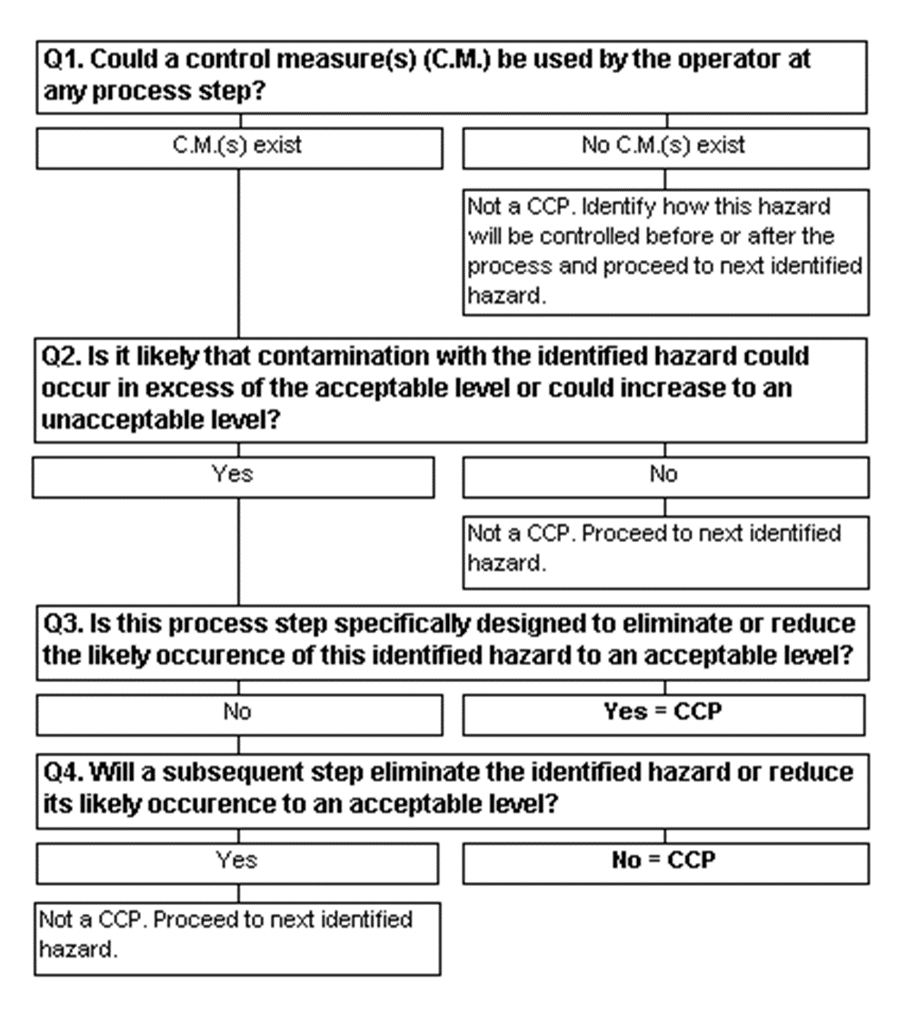
Principle 2
Correct determination is vital
Logical approach required:
  Decision trees often used
    Not essential
Notes:
Correct identification of CCPs is essential – it is up to the business on how they determine the CCPs – but a lot use decision trees.
There are 3 main types which are used. The Canadian Model which is shown here, there is also one in Codex and BRI Camden have one aswell.
There is no legal requirement to use a decision tree but they can be useful to help ascertain that the CCP has been identified correctly. It lays out a logical sequence of questions which it is up to the FeBO to ask in order to determine if it is a CCP or not.
Q1 – If identified a hazard and no controls can be applied then need to think about what else they can do – do they need a control?
Q2 – look at process steps – could hazard be realised at this step – if yes move on. If not then not a CCP.
Q3 – Are you doing something at this process step to deliberately control a hazard, e.g. pelleting to reduce moisture content,
Q4 – if not specifically designed to remove the hazard will another step control this – if not then is a CCP, if yes then that other step will be the CCP
Questions for you on Inspections could be – why did you determine this to be a CCP – to see their decision making process
Businesses lose sight of the fact that just because it is not critical doesn’t mean that it is not controlled – all other need controlling as well – they are just not CCPs

Slide 58
Principle 3
Establish Critical Limits

Slide 59
Principle 3
Establish critical limits
  Max/min value at which parameter must be controlled at CCP to control hazard
  Critical limits can be based on:
    Additive levels
    Tolerance levels for pesticides or mycotoxins
    Temperature
    Contact time
Notes:
For each CCP the business must establish a critical limit on what is acceptable and what is not. This limit can be based on lots of things, often things like temperature and time but could be other things.
If there is a legal limit then it is likely this is what is used, e.g. contaminants
Don’t want vagueness – whoever is checking these limits do they understand it – what the limit is.

Slide 60
Principle 3: In practice
Critical limits for mycotoxins:
  Maize: B₁ 5.0 µg/kg, Total 10.0 µg/kg
  a_{w} < 0.70
  Moisture content < 14%
Notes:
For example for mycotoxins levels are set out in law. So use the legislation to set the limits, it gives the business a legal reference to explain why they set the level there.
So for maize delivered if above legal limit – not much can be done about it so CCP at intake? Then looking to control storage after intake to stop mycotoxins occurring/developing when on site.
In the example the business has found the legal limit for mycotoxins in maize, and worked out this occurs where water activity is above 0.7, which relates to a moisture content of 14% - which they could monitor. On inspection question how they got to this – is there scientific substantiation behind their decisions.
Some businesses use critical limits based on law, but will use target limits for operations purposes as worried about working to legal standards – it allows them more “wiggle” room. The different between target limit and critical limit is the tolerance which you may see in HACCP systems.

Slide 61
Principle 4
Establish monitoring procedures
Notes:
For every CCP we have set a critical limit and then we need to monitor this, to see if critical limit has been breached. So monitoring only required at CCP’s.

Slide 62
Principle 4
Establish monitoring procedures
  Planned sequence of:
    Observations
    Measurements
  Effective monitoring involves trend analysis
    Intervention before loss of control occurs
  Loss of control at CCP = Imminent risk
Notes:
Monitoring is a planned sequence of observations and measurements – how often (frequency) of monitoring is up to the business – but you could ask them to justify why they choose this frequency.
Monitoring can be measurements so you actually do something, take a temperature etc or an observation – can look to see a change etc.
For aflaxtoxins this may be both you could see the mould but can’t rely on this as mould may be cleaned off so would need to measure as well.
You are monitoring of the CCP for critical limit. If monitoring identifies that the critical limit not achieved at the CCP and HACCP done properly then there is likely to be an imminent risk to health – as such we need to think about what we would do in terms of enforcement
Detain/Seize – product that is there
Emergency Prohibition notice to stop the process from producing further batches
Talk about enforcement here….
We run a separate 1 day enforcement sanctions course which you may be interested in!

Slide 63
Principle 4
Monitoring of controls:
  Only required at critical points
  Frequency depends on:
    Nature of product i.e uniform size
    Nature of process i.e automated/manual
    Nature of production i.e batch size
    History of previous checks
Notes:
As we said how often they monitor is up to the business. If ongoing then start regularly and if no issues reduce accordingly. Frequency can depend on……
If moniroting at a target level then will do trend analysis. If moving towards critical limit, then corrective actions kick in to stop actual limits being breached.

Slide 64
Principle 4
Monitoring may include:
  Temperature checks
  a_{w} checks
  Visual checks
  Timing of process
  pH checks
  Gas monitoring (MAP)
  Chemical analysis
Notes:
Inline monitoring – continuous monitoring – e.g. probes in line to continuously monitor
- non-continuous monitoring – meter in a continuous process to measure temp, moisture etc. not take sample out.
Offline moniroting – take a sample and do something with it.
Key point is monitoring must be a real time thing – not get result later than day/week, e.g. micro examination not acceptable as not real time. ATP tests can be real time.

Slide 65
Principle 4
Microbiological examination
  Seldom effective form of monitoring
  Most effective as verification tool
Chemical analysis:
  Better to measure conditions rather than contaminants
  Rapid tests may be useful
Notes:
May be able to monitor aflatoxins effectively.
Better to monitor conditions rather than content for chemical to get a real time result.
Pre-requisites – verifying these as being correct, use analysis/examination to verify if all working – precaution better than cure
Issues if business doesn’t know how or why they sample the product – not representative – mycotoxins only in “hot spots”.
If never has a failure why sample so often? If rely on sample records not focusing on prevention – looking at wrong end.
If never had a failure for 20 years why not reduce frequency of sampling?

Slide 66
Principle 5
Establish corrective actions

Slide 67
Principle 5
Establish corrective actions
  Essential when deviation from critical limits occurs
  HACCP plan should identify:
    Action required when deviation occurs
    Who is responsible for implementing corrective action
    What records should be made
Notes:
If critical limit not adhered to then need to take corrective action.
Contingency planning – what will business do – often destroy product written in plan but in practice this doesn’t happen – look for honesty – as businesses will lie to you! So check with a doubtful mind.
Not do it on the hoof – think about this at an early stage.
One business found that feed(soya from China contaminated with salmonella) was treated like nuclear waste – went to biodigestion – risk in storing feed as eaten by birds - $26,000 worth of feed – businesses need to consider this at an early stage
Depending on the feed may need specialist contractors to dispose of the waste – which will cost

Slide 68
Principle 5
Some corrective actions specified in pre-requisites i.e:
  Product withdrawal
    NB requirement for FBO to inform competent authority if unsafe feed has left their control. Article 20 of 178/2002
Notes:
For some corrective actions the law will guide a business such as 178/2002 where for unsafe feed they will be required to withdraw it from the market.

Slide 69
Principle 5
Effective corrective action involves:
  Investigation of cause and correction of non-compliance
  Identify and retrieve affected product
  Record the above
Notes:
Another part of corrective actions and maybe the most key element is looking at why it went wrong – investigation into the cause of it (root cause analysis). In addition to this look at what other products/batches were affected which may lead to a product withdrawal or recall, notification to the FSA and Local Authorities etc.

Slide 70
Principle 6
Establish verification procedures

Slide 71
Principle 6
Establish verification procedures
  Includes validation
  Check that HACCP is being implemented
  Ensure that all controls are scientifically sound
  Independent verification useful
  Additional verification required:
    For new products
    Where new hazards identified
Notes:
Verification is in 2 parts, the first is validation, can the business validate why the hazards are significant, why they set critical limits for CCPs where they did etc. This should all be based on science – which can be tricky for some businesses.
Lots of verification/scientific methods already written and recorded. FAO guidance – manual on mycotoxin present in feed.
If normal feed and processes will be docuemnts/references to look at. So HACCP just points to them – make sure it is a reputable body e.g. standard in law, standard industry guidance, assurance schemes, FSA guidance, Codex, FAO, commission guidance. Point to a reputable body – IFR, BRI etc. Academic bodies.
For new products/processes they may need to do the research to validate this. May be need to sample.
After the validation which you can inspect and ask questions on, they need to verify that the system works. This is where they could take samples of products to show that the feed is safe etc and the system works.

Slide 72
Principle 7
Documentation

Slide 73
Principle 7
Establish documentation
  Should include:
    Summary of hazard analysis
    Rationale in hazard identification
    HACCP team / responsibilities
    Description of food, distribution etc
    Verified flow diagram
    HACCP plan diagram
Purpose of documentation
  To ensure effective implementation
Notes:
Codex system requires that everything is written down but for EU law docuemtns just need to be relevant to the business – and remember the idea of flexibility.
Example of documents they may have are….

Slide 74
Maize based animal feed
A Case Study
Notes:
So we will now look at an example – for a maize based animal feed. So this is going back to the start and apply the principles practically!

Slide 75
HACCP team
Plant manager
  Deputy
Quality control manager
Procurement manager
Senior engineer
Laboratory manager
Notes:
The first step is to put together the HACCP team – what do you think of this team, anyone missing?
It’s a typial example of a HACCP team, but doesn’t have anyone from the shop floor present, they are all managers.
This team will know the technical aspects, and the manager msy know all the jobs from experience, but this may have changed since.
Find out what happens in practice and helpful to have person who will be doing it to raise issues. Practicalities is key – e.g. H&S issues, guards etc may stop certain activities – make it easier to do it in practice to ensure it is done, gor example if written record are required can the operator get to them easily..
You can’t specify what the HACCP team is. But if root cause for HACCP issues is that records not kept due to practicalities may be operational staff not on HACCP team.
Team should be representative of all levels of the organisation which may include operational staff, HR – for training, maybe Directors to sign off on financial elements of implementing HACCP.

Slide 76
Product description/ intended use
Notes:
We then describe the product – what is it, specification, who it is intended for etc.

Slide 77
Flow diagram
(verified)
Notes:
We then create the flow diagram for the processes the product goes through. This starts are procurement of the maize to storage, mixing, pelleting, packaging, labelling, storage, transport etc.
Identify the scope of the HACCP. This is a long one it may stop at stage of feed up taken by haulier.
The last steps helpd to understand the intended use of the product – what is reasonably likely to happen to the feed.
Additional labelling may help to avoid the hazards for example.

Slide 78
Hazard analysis –
Identification/evaluation of hazard
Maize susceptible to:
  Aflatoxins, fumonisin B₁ and ochratoxin A
    Can have several mycotoxins present
  Scientific studies demonstrate aflatoxin by far most prevalent
    Other mycotoxins theoretically associated with maize
  Therefore HACCP will consider control of aflatoxins
Notes:
The HACCP team then need to look at the hazards – HACCP team looked here at aflatoxins as being the likely issue as others just an issue in theory – so only aflatoxins are significant in this instance.
Also, if they control aflatoxins then the other hazards should be controlled as well.

Slide 79
Hazard analysis – likely occurrence of hazard
Aflatoxins in incoming feed
Contamination unlikely
Contamination unlikely
Contamination unlikely
Too much water added can promote aflatoxin production
Contamination unlikely
Appropriate labelling required
Feed not stored for more than 3 days
Contamination unlikely
Contamination unlikely
Poor handling may result in contamination
Notes:
So know we know the hazard is for aflatoxins we go back to the flow diagram and work out where it is likely to occur.
This has shown it is likely in the incoming feed (for example from imported/brokered feed), during the peletting where too much water can cause issue, it needs to be labelled appropriately and then how long it is stored in our warehouse. It then may be contaminated on the farm as well.

Slide 80
Hazard analysis - controls
1) Purchase of ‘certified’ maize Sampling and positive release Control of moisture content
5) Use of dry steam and appropriate cooling of pellets
7) Details of animal species, conditions of storage and use
11) Durability date provided. Advice on cleaning of feed dispensers given
Notes:
Now that we have identified our significant hazard and where it may occur we now need to work out controls for them.
When maize delivered a positive release system put in place – need lab test certificate and take a sample themselves for moisture control before being unloaded.
5) To precvent too much moisture in the pellets
7) & 11) On the labels

Slide 81
Identification of Critical Control Points
CCP 1
CCP 2
Notes:
Just for the aflatoxin hazard we need to establish which if any are CCP;s.
The business have identified 2 CCP’s one at intake at step 1 as nothing later in the process that will get rid of the aflatoxins.
CCP 2 at the peletting as residual moisture issues exist which need to be controlled.
The labelling will be dealt with through pre-requisites along with other issues.

Slide 82
Critical limits
CCP 1
  B₁ 5.0 µg/kg, Total 10.0 µg/kg
  a_{w} < 0.70
  Moisture content < 14%
CCP 2
  Moisture content of pellets 13%
  Dry steam 110°C
Notes:
For each of the CCP’s we need to establish critical limits.
Limits on incoming maize could be set in specification – lab analysis could control this (certification). Set water activity and moisture to see if any aflatoxin present and if mould present – prevent its growth.

Slide 83
Monitoring
CCP 1:
  Rapid aflatoxin test of each batch
  Moisture check each batch
CCP 2
  Moisture check each batch
  Alarmed thermocouple in steam line
Notes:
This is real time monitoring at each of the CCP’s identified.
At CCP1 there is a screen test for aflatoxin it gives a direct indication. Niton analyser could also be used if additional patch purchased – could be costly.
Could check moisture as well to stop further growth.
At CCP2 check the moisture and the steam is linked to an alarm (continuous monitoring)
The business have decided to do this on every batch in terms of frequency.

Slide 84
Corrective action
CCP 1:
  Aflatoxin:
    Reject batch
    Investigate supplier
  Moisture
    Dry or reject
CCP 2:
    Additional drying
    Investigate process
Notes:
Now the business have to establish the corrective action at each CCP.
This is a key point on inspection – what happens.
Aflatoxin level – further checks on supplier as why not met the specification – change supplier and reject the batch
Moisture – put it right (dry product) or reject – when will they dry, and how and when will they reject (rejection unlikely in practice)

Slide 85
Verification
Validation
  Aflatoxin levels
    Directive 2002/32/EC
  Moisture levels:
    FAO Food and Nutrition Paper 73 (2001)
  ISO accredited laboratory methods
  Equipment calibration to industry standard
Verification
  Targeted sample plan.
Notes:
Industry standard – just because everyone does it doesn’t always mean ti is right, but may not be wrong either.
Looking at scientific substantiation – for aflatoxin levels there is a legislative level of 0.01 mg/kg for complete and complementary feed (some exemptions from this level though).
If they are looking to link it to moisture levels for monitoring then there is the FAO (Food and Agrculture Organisation of the United Nations) Food and Nutrition Paper – they have used a standard document – science based so relying on this to validate their system
Then verification of the system – does it work in practice – targeted sampling best way to do this initially. Samples at all stages of the process to being with – show it all works. May include equipment. Does equipment work. When all shown to work can step down the levels of verification being done.

Slide 86
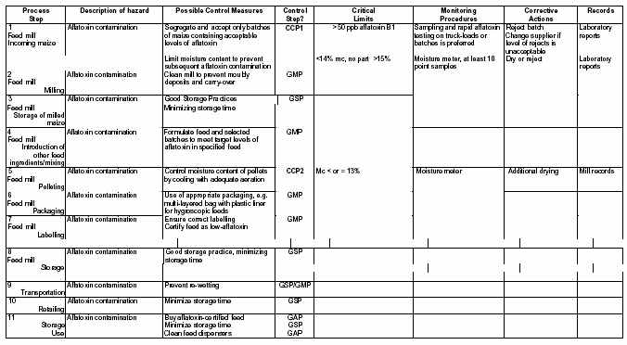
Documentation
Notes:
Then finally there is the documentation – identify process steps, hazards, controls, CCP, limits, monitoring corrective action, where records kept and verification
The business may include all process steps or they may just list CCP’s.

Slide 87
Documentation
Records maintained of:
  HACCP plan
  Monitoring of CCP 1 and CCP 2
  Deviations
  Corrective actions
Notes:
This business has kept records of the HACCP plan, monitoring records, deviations from target limits and then corrective actions. – Focus on these on inspection records kept at CCP1 and 2.
EH will generally look at the system, process, identifying hazards CCPs etc but focusing on micro and physical hazards not chemical – so may miss contaminants etc. For approved premises EH shouldn’t approve until assess HACCP and look at all hazards including chemical – if not do this shouldn’t approve. But they don’t talk to TS so salmonella covered but not anti-biotics or pesticide residues for example.

Slide 88
Assessment of HACCP Systems

Slide 89
Assessment of HACCP
Two methods of assessment:
Assessment of compliance with Codex
  Not a legal requirement
Assessment of compliance with legislation
  ‘System based on HACCP principles’
Notes:
There are two methods of assessment – the Codex which is above the leval requirements- non compliance with codex does not necessarily mean a breach of law. Unless also fails to meet the legal requirements such as not identifying a hazard altogether, or not identifying a CCP – breach of law. The reason for not identifying it may be they didn’t have a flow diagram so you could recommend they put one in place – can’t force them to though.
Your inspections/audits will be assessing compliance with a system based on HACCP principles – which is what the law requires.
If you pre-book your inspections there may be issues – Tudor Meats in South Wales – pre booked visits and all details in place on visit, all records done etc. All records found to be done just before the visit. E-coli outbreak and 1 person died. It was discovered during a public health enquiry that all the visits were announded and the records completed when they needed to be. So should only do announced visits when justified.

Slide 90
Assessment against Codex
Standard aide memoire
  Assessment of:
    Documentation
    Preliminary steps
    Application of HACCP principles
Notes:
The FSA are keen on an audit approach to HACCP – logical/sequential approach to HACCP.
You may have your own forms/documentation to assess HACCP systems but there is a standard aide memoire which you may find useful – go through form with delegates (at back of pack)
The form is in 2 parts, one a desktop assessment the other on site.
Each part has a series of scores with an overall score – this helps to demonstrate whether the system is sufficient or not – but you don’t have to score it. It is a useful tool to use as it can be difficult to express how good or bas a system is, but the score is subjective and a discussion point to have on inspection.
You could ask the business to send a copy of their plan thorugh to you before the visit so you can do the pre-visit part of the assessment and score 0 for anything they didn’t send so you could look at on inspection to get these docuemnts. You would then look at the records and verification elements on the visit to speed the process up.
Things to consider – have they identified “all” significant hazards – not just most of them
Not everything is a CCP – in reality will only have a few
Form used as basis of opening meeting – clarify points, get further documents, focuses the inspection/audit.
Remember the form is based on CODEX HACCP so they may not have full details of HACCP team etc.
The comments/notes section is useful to record your thoughts/matters to go through/confirm on the visit.

Slide 91
Questions/summary
Notes:
Does anyone have any questions?
CPPD certificates and feedback forms!

