Slide 1
Introduction to Vacuum Packing and Modified Atmospheric Packaging

Slide 2
Agenda
9.30 Registration
9.45 Welcome and Introduction from workshop speakers: John Bassett, Sandra Moore
9.50 Introduction to VP/MAP
Technology
Microbiology
Foods
10.20 Machinery and Packaging
Types of machines and packaging
Monitoring/testing
Cleaning
11.00 Refreshments

Slide 3
Agenda
11.15 Machinery and Packaging (cont)
11.30 Microbiology and VP/MAP
Hazards
Growth
Control measures
Shelf life determination
12.30 Lunch
13.15 Microbiology and VP/MAP (cont)
14.15 Guidance/Legislation
14.45 Refreshments
15.00 Case study
16.15 Complete questionnaires, collect CPD certificates and depart

Slide 4
Background
Delivered by CIEH on behalf of FSA
Tutors:
John Bassett, Food Safety Consultant
Sandra Moore Environmental Health Consultant CMCIEH

Slide 5
House Keeping

Slide 6
Aims and Objectives
Increase knowledge and understanding of food microbiology and control of pathogens in relation to vacuum packing and modified atmosphere packaging
Understanding of the type of samples that should be taken and interpretation of the results
Understanding of enforcement issues

Slide 7
WHAT IS VACUUM & MODIFIED ATMOSPHERE PACKING?

Slide 8
VACUUM PACKING (VP)
VP is the removal of all gases (air) from the inside a pack surrounding a food product.
This results in a tight seal around the product which keeps air out and thereby restricts the growth of aerobic micro-organisms.

Slide 9
Vacuum Packing
Limited package headspace
<1% O₂ (not complete vacuum)
10-20% CO₂
restricts growth of (aerobic – oxygen using) spoilage organisms
Reduces spoilage due to oxidation – the process that causes apples and bananas to turn brown, for example

Slide 10
Modified Atmosphere Packaging (MAP)
MAP is the placing of a foodstuff in
- a sealed pack and either gas flushing with a pre-selected gas mixture before sealing
- or allowing the product to change the gas mixture itself
There is no control of the mixture once the package has been sealed

Slide 11
Modified Atmosphere Packaging
Packaging in an atmosphere different from that of normal air (listed in EU Reg No 1129/2011)
Air - standard composition
78% N_{2,} 21% O_{2,} 0.94% Argon (Ar) and 0.03% CO₂
Very effective preservation technique, particularly for chilled perishable foods
Shelf-lives extensions from 25 - 400 %

Slide 12
Controlled Atmosphere (CA) Storage
CA Storage is a procedure where the gas within the chamber (or pack) is maintained at specific pre-set ratios
Controlled atmosphere storage is utilised by large warehouses and shipping companies to maintain a constant gas equilibrium within the storage area e.g. for fruit/veg

Slide 13
Modified Atmosphere Packaging
Generally MAP is low O₂, high CO₂ for microbial inhibition and oxidation prevention (exceptions)
MAP includes active packaging - atmosphere changes during shelf-life e.g. oxygen absorbers or carbon dioxide emitting films
‘Non-respiring’ products e.g. Meat, fish and cheese - very low gas permeability to maintain the initial gas mixture inside the package.
‘Respiring’ products e.g. fruits and vegetables, permeability of the packaging film adapted to the products’ respiration, so equilibrium of the gas mixture will establish in the package

Slide 14
A wide variety of products gas-flushed
Fresh meat and poultry
Fish and seafood
Processed meat
Cheese
Milk powder
Fresh pasta
Fruit and vegetables
Ready Meals
(source modifiedatmospherepackaging.com)

Slide 15
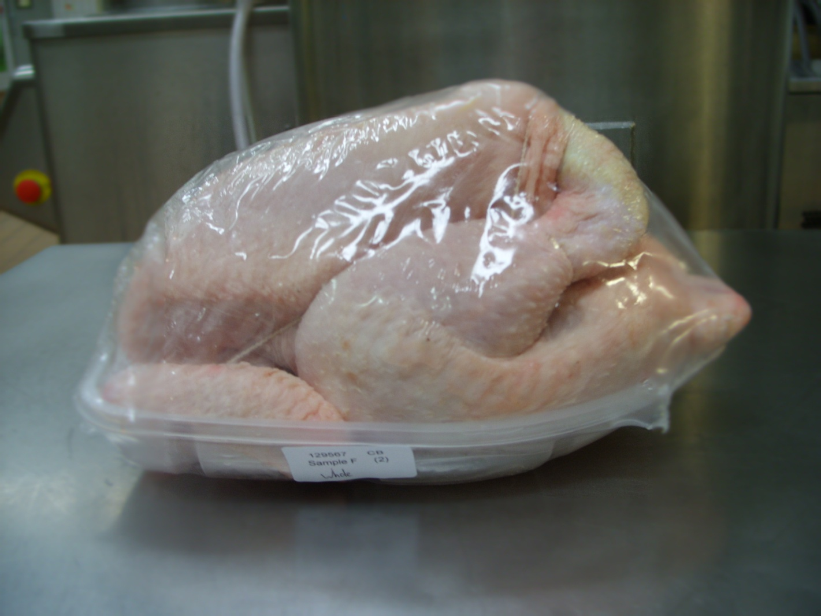
Gas Flushed Whole Chicken

Slide 16
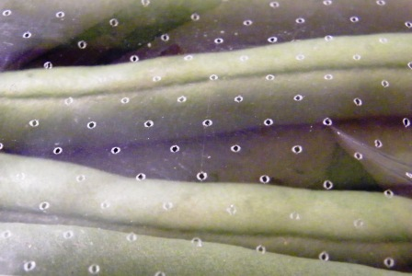
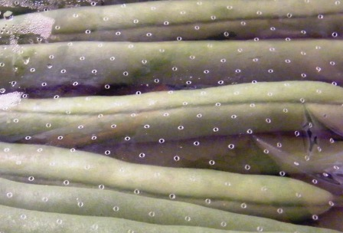
Fresh Vegetables - Perforated

Slide 17
Vacuum or MAP?
Depends on the product being packaged. Vacuum packaging a ‘one size fits all’ technology – it relies solely on removing air
MAP can be tailored to the particular foodstuff
Different gases/proportions to give the maximum shelf life, quality and appearance for product
(source http://modifiedatmospherepackaging.com/)

Slide 18
MAP Effects on Microorganisms
MAP will not completely prevent microbial growth! In particular, concern that retard spoilage but not pathogens.
It will selectively inhibit particular groups of organisms
Its effect will vary depending on the gas conditions used
e.g.elevated levels of carbon dioxide retard the growth of fungi and Gram-negative psychrotrophs
It is used with other inhibitory conditions to gain effect (low temperature)
Refer hand out for specific product/gas mixtures used

Slide 19
MAP Efficacy affected by:
Product temperature
Product to gas (headspace) volume
Initial microbial loads/types of flora
Package barrier properties
Biochemical composition of the food
(Loss and Hotchkiss, in Control of Foodborne Microorganisms, 2001
Vijay K. Juneja, John N. Sofos, eds)
Does the manufacturer understand the effect and limitations of the technology?

Slide 20
High Oxygen MAP
70-100% oxygen
Inhibits both aerobic and anaerobic microorganisms
Inhibits enzymic discoloration
Prevents undesirable moisture and odour losses
Effective against Campylobacter

Slide 22
Other gases used - Nitrogen (N₂)
No specific antimicrobial effect
Inert and tasteless
Functions as a ‘balance gas’ to replace O₂
Not very soluble in foods
Prevents pack collapse caused by CO₂ absorption

Slide 23
Other gases used - Argon (Ar)
Inert gas – USA (GRAS) and EU approved
Proposed as an alternative to N₂
Inhibits
- enzymic activities
- microbial growth
- degradative chemical reactions
- fungal growth
Reduces ethylene emissions
Reduces respiration rates of produce
Notes:
Miscellaneous additives permitted for use in EU
4 times more effective at displacing air so less argon is required in the pack than nitrogen, however argon is a more expensive gas than nitrogen

Slide 24
Other gases used - Nitrous oxide (N₂O)
‘Laughing gas’
Permitted food packaging gas in UK
Sensitises microorganisms to antimicrobial agents
Used as a propellant in whipped cream cans

Slide 25
Other gases - Carbon monoxide (CO)
Highly toxic gas (Use at 0.4%)
Has been found to be beneficial for some food applications, e.g.
- maintaining red colour of raw meats
- maintaining the red stripe on salmon
- reducing fresh cut produce discoloration
Not a permitted packaging gas in the EU
GRAS status in USA
Notes:
Colourless, tasteless, odourless
Banned for use in the EU due to toxicity and explosive nature in air
Mainly known for maintaining the red colour of meat
Used in USA with fresh produce to prevent browning of lettuce when used with low oxygen
Less than 1% required to inhibit many bacteria, yeasts and moulds
Lobbying to reuse again?

Slide 26
WHAT ARE THE ADVANTAGES OF VACUUM PACKING FOOD?

Slide 27
Extends shelf life, reduces wastage
Turnover increase, more variation and spread in product range
Optimal product and hygienic storage
Prevents drying out, moulds’ and freezer burn
Improve product quality product matures in packaging no loss of flavours
Optimal packaging contributes to food safety and HACCP standards

Slide 28
SUITABLE FOODS FOR VACUUM/ MODIFIED ATMOSPHERE PACKAGING

Slide 29
In theory all foods can be vacuum packed but in reality the most likely types of food that are routinely vacuum packed are fresh foods such as meat, fish, poultry, vegetables, fruits and stocks and sauces to extend shelf life and sous vide cook as well as dry foods such as cereals, nuts, cured meats, cheeses, smoked fish and coffee to solely extend shelf life.
Notes:
Limitations in size and scale of packing.
Size of Machine and pouches

Slide 30
TYPES OF VACUUM PACKING MACHINES

Slide 31
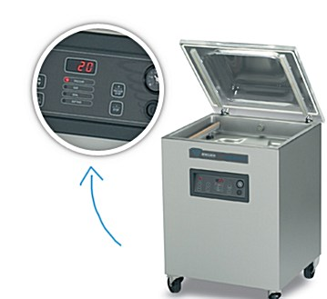
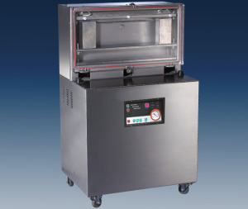
Free Standing Horizontal
Free Standing Vertical

Slide 32
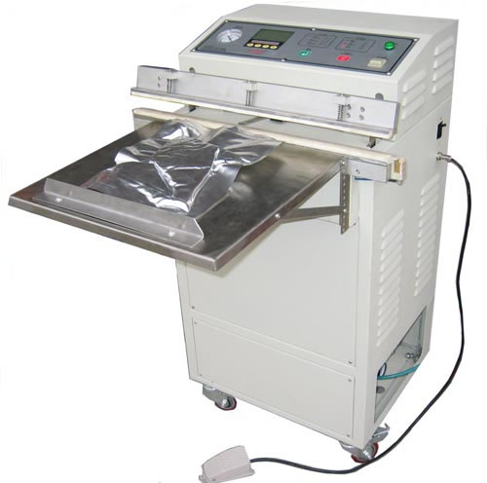
External Vacuum Packing Machine

Slide 33
HOW DOES A VACUUM PACKING MACHINE WORK

Slide 34
Traditional chamber types that creates a vacuum in a pouch by placing the entire contents of a pouch within a chamber and extracting the air from the chamber before heat sealing the pouch.
External suction machines use a vacuum pump to suck air out of a pouch from the exterior of the appliance, i.e. by placing the open end of the pouch underneath a lid, withdrawing the air and then heat sealing the pouch.

Slide 35
In essence the workings of a vacuum packer are very simple. The vacuum packing machine consists of a hermetically sealed chamber from which all or part of the air is inside the chamber. This is extracted by a pump consisting of rotating blades that absorbs and expels air. A vacuum pouch is then sealed with a heat produced by thermal strips.
It is also possible to create a vacuum and seal the bag inside a box chamber (called a chamber machine) and in others it is possible to drawer a vacuum from a pouch whose open pocket is placed under a lid of a machine and heat sealed whilst under vacuum pressure (called an external suction vacuum sealer).

Slide 36
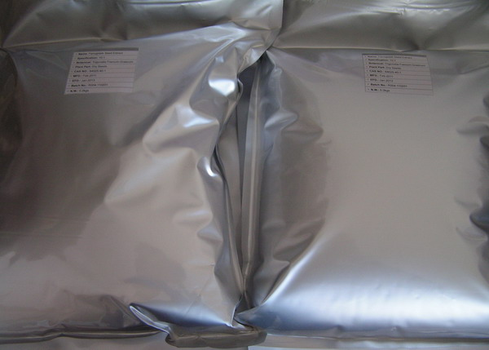
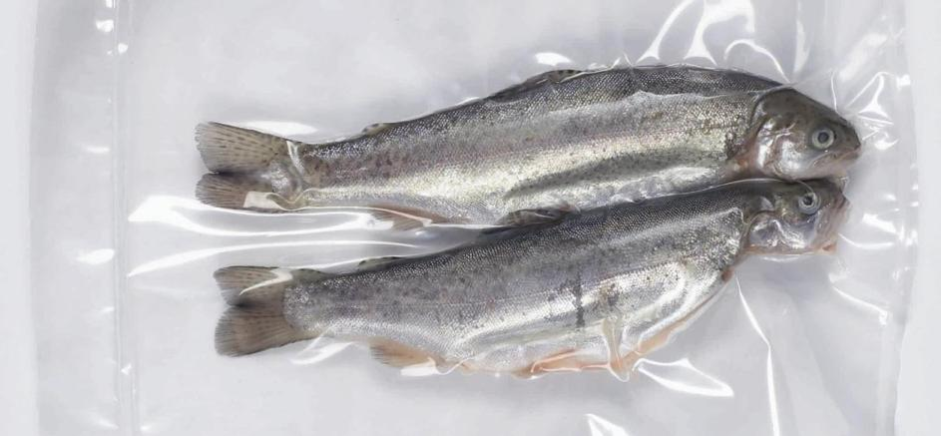
VP & MAP PACKAGING

Slide 37
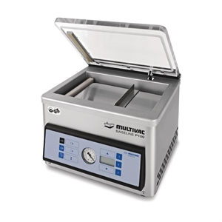
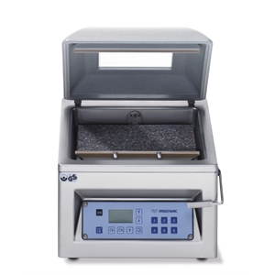
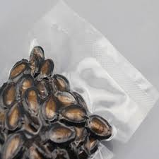
Table top models

Slide 38
FACTORS AFFECTING CHOICE OF PACKAGING MATERIALS
Gas Permeability
Water Vapour Transmission
Mechanical Properties (integrity)
Sealing Reliability
Material Type
Notes:
Important that the material does not change on storage – that it is stable and that it does not allow excessive of gas from the environment into the pack. If barrier packaging is not suitable for the purpose then the desired atmosphere will not be maintained. Recommended that the suitability of the packaging system used is assessing and measuring the conditions of the pack after storage.
Water Vapour Transmission – important that the packaging used does not allow excessive transfer of moisture. Loss of water moisture from the pack may lead to a decrease in product quality whilst any ingress of moisture to the pack may disturb the balance of the preservative factors, which in turn may lead to food safeyt being compromised.
Mechanical Properties material must be suitable to withstand puncture and the mechanical stress during normal pack handling. When the wrong type of packaging is used , excessive damage, gas leakage or loss of vacuum could occur.
Sealing reliability – in both processes seal integrity is extremely important to ensure the correct internal atmosphere is maintained
Material Type – the material used will be different for VP and MAP and will consist of different components and specific characteristics.

Slide 39
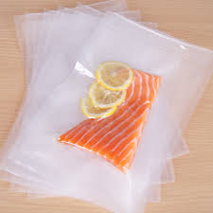
Packaging must comply with the Plastic Materials and Articles in Contact with Food Regulations 2008
Compliance statement should be obtained
Notes:
Compliance statements are from Manufacturers stating that packaging meets the requirements of legislation.

Slide 40
Embossed vacuum pouches which are also sometimes called ribbed, textured or channeled bags are suitable for external suction vacuum sealers. These bags are also suitable for use when drawing a vacuum outside the chamber of a chamber type vacuum packer and have a temperature tolerance of 70° C.
Standard preservation vacuum pouches in various thicknesses of 90µ, 140µ and 200µ that can be used solely in a chamber type vacuum packer. The thicker the micron the less likely the bag will puncture when vacuum packing boned meat and sharper objects like speck, parmesan and rice. The maximum temperature tolerance for these bags is 70° C.
Notes:
FBO needs to monitor gas levels in packaging and this should be monitored and tested

Slide 41
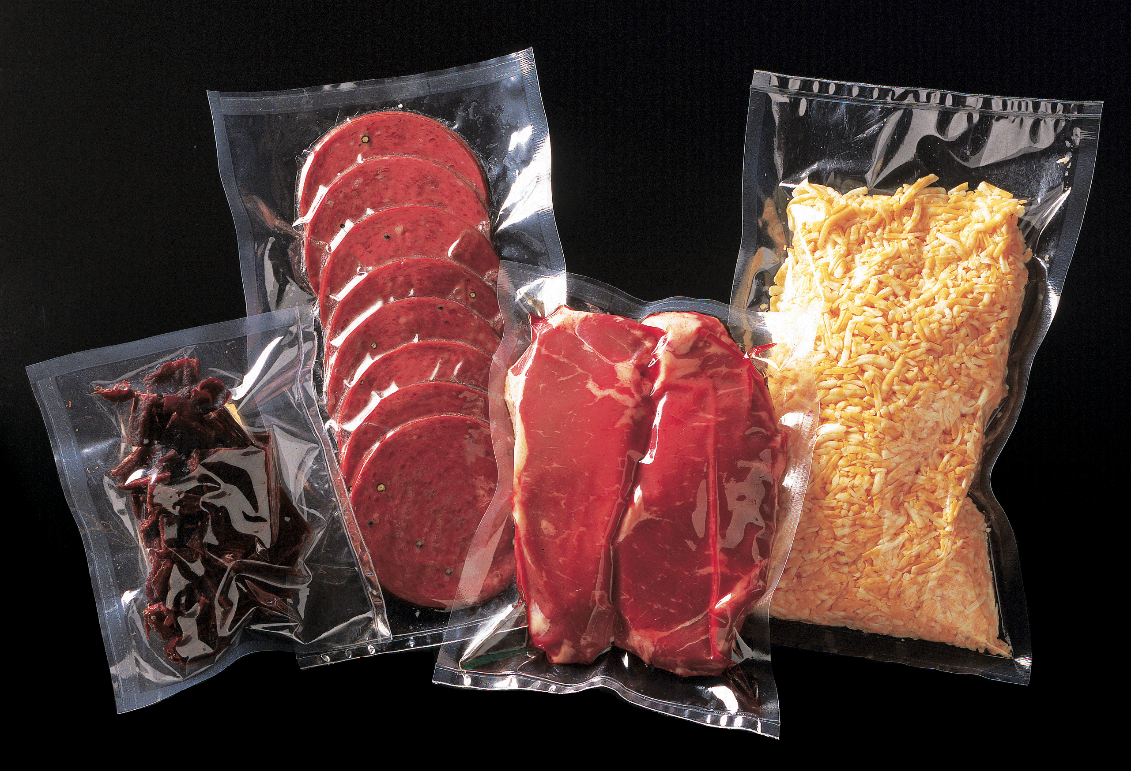
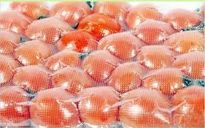
Standard Pouches
Embossed

Slide 42
GAS MEASUREMENT
Equipment available to measure gas in packs.
Off-line
- Bench top
- Hand held
On-line
- Equipment based

Slide 43
GAS ANALYSIS
For MAP products routine analysis of gas mixture
Use of a Gas Analysis Machine
Notes:
Advice on how to use from the manufacturers. Carried out as part of a routine start up procedure.

Slide 44
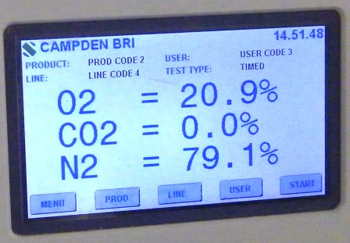
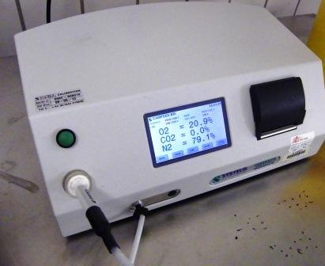
Gas Analysis

Slide 45
CHECKS
Check levels (0.3?)
Use of gauge/s
Examination of pack
Tightness
Loose pack
Air spaces in pack

Slide 46
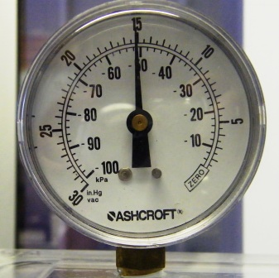
Vacuum Measurement
Use of Vacuum Gauges

Slide 47
SEAL INTEGRITY –ESSENTIAL CHECKS
Alignment of the sealing head
Dwell time
Temperature
Pressure
Machine Speed
Size of packaging used for product

Slide 48
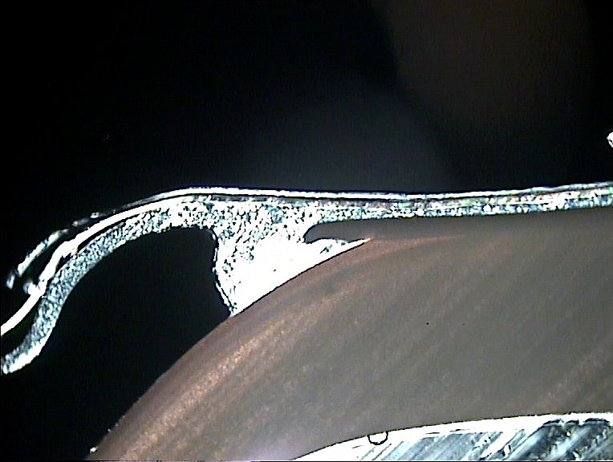
Heat Seal (X-section)
Lidding Film
Heat Seal area
Base Material

Slide 49
SEAL QUALITY
Determined by
Materials – must be compatible
Cleanliness of seal area
Maintenance of sealing equipment
Sealing bars
Time/temperature/pressure

Slide 50
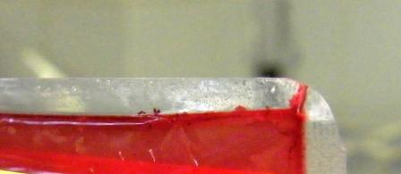
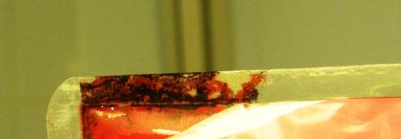
Dirty Seal Area

Slide 51
Seal Faults – Folds/Creases
Folds –
These can result in leakage routes

Slide 52
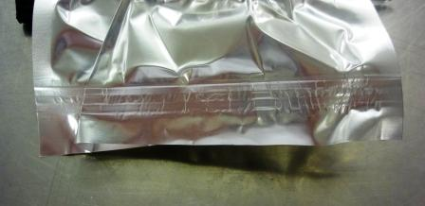
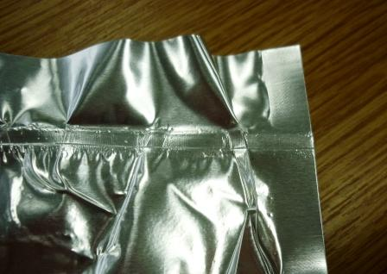
Seal Faults – Folds/Creases

Slide 53
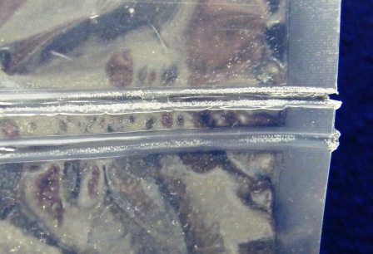
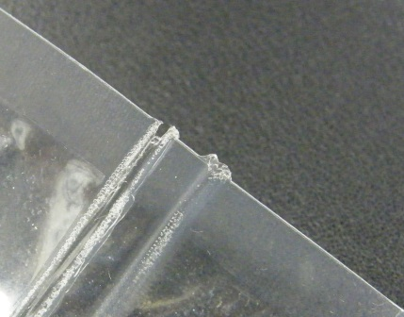
Seal Faults - Heat

Slide 54
TESTING SEAL INTEGRITY
Non Destructive Tests
Destructive
Notes:
Visual and Manual inspections
On production line then an automated in line testing where pneumatic plungers measure pack resistance to pressure automatically rejects leaky packs
Destructive Tests are usually carried out when the equipment is being set up and includes
Burst test
Leak test
Electrolyte test
Dye penetration test
Drop test
Peel test

Slide 55
TEST METHODS
Visual
“Squeeze” type tests
Dye Test
Electrolytic Test
Inflation test (Burst test)
Compression test (Burst test)
Tensile/peel test

Slide 56
TESTING
Visual tests
delamination
dents, tears,
obvious leaks
shape of package & alignment of seals
heat damage
fouling of seals

Slide 57
“SQUEEZE” TYPE TESTS
Testing by Hand
Squeeze pack looking for seal failure
Bubble leaks – squeeze pack in water (Bucket?)
Caution – size of hand! Variation?

Slide 58
DYE TEST
The dye test is limited to the detection of individual leaks particularly if a number of leaks are present.
Penetrant dyes put into pack/seal area and left for a set period of time.
The seals are examined for dye penetration.
The dye indicates when leaks are present and also identifies their position

Slide 59
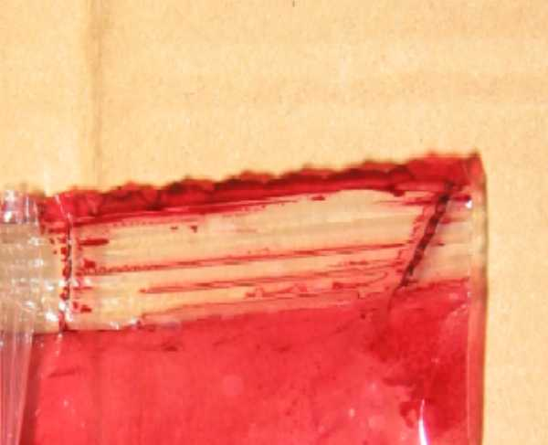
Dye Test

Slide 60
LABELING
Must comply with current regulations
High risk food must be labeled with use by date and storage conditions e.g. temperature; consume within 3 days of opening
Cooking or reheating instructions ( must be based on proper evaluation of product safety
Ingredients
Manufacturer’s name and address
Any other information required by specific legislation e.g. FIR

Slide 61
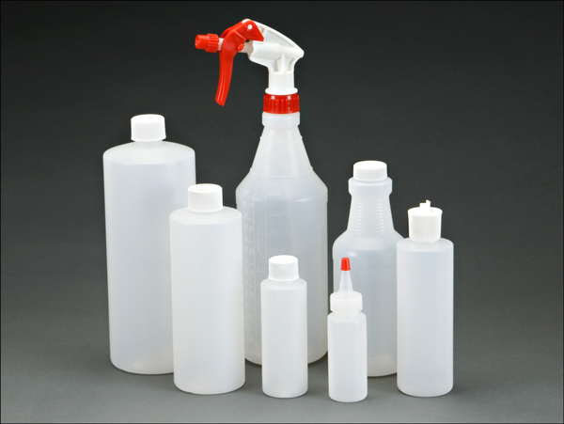
CLEANING OF MACHINERY

Slide 62
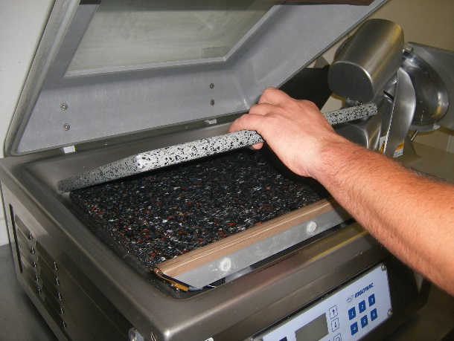
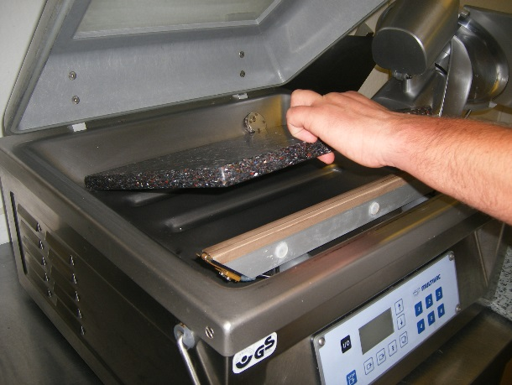
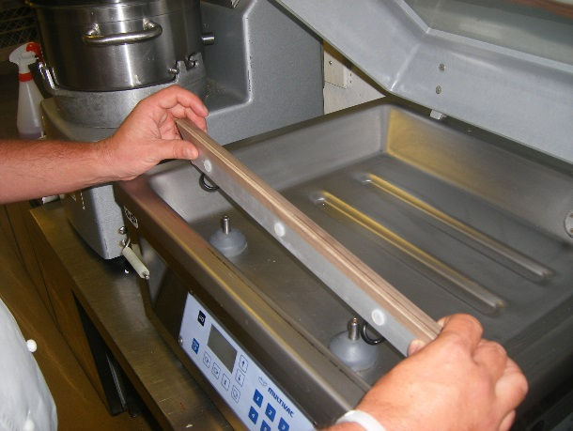
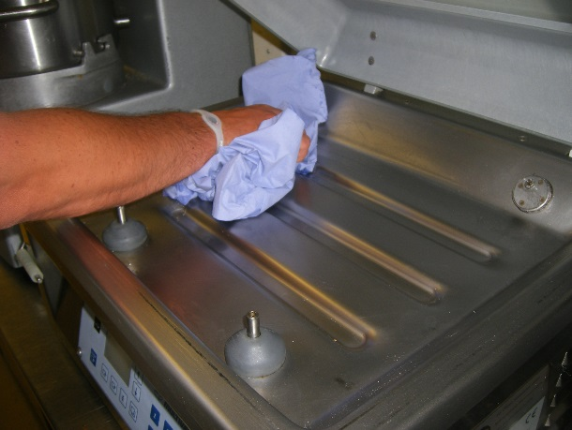
Step 1- Remove top board
Step 2 – Remove bottom board
Step 3 – Remove heating bar
Step 4 – Remain main debris

Slide 63
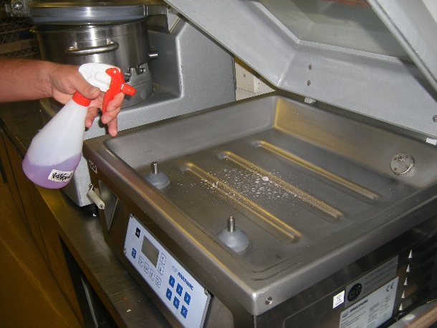
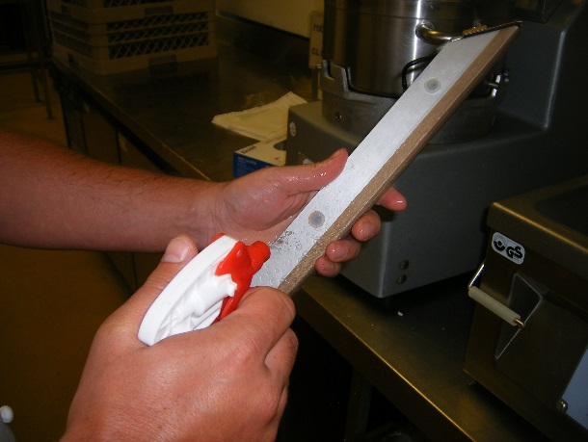
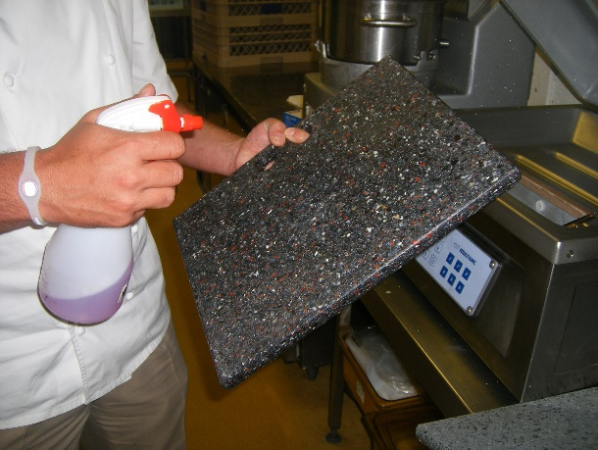
Step 5 – Sanitise base
Step 6 – Remove sanitiser
Step 7 – Sanitise sealing board
Step 8 - Sanitise each board

Slide 64
REMEMBER – AVOID CROSS CONTAMINATION AFTER THOROUGHLY CLEANING UNIT – SPRAY SANITISER FOR A SECOND TIME THEN ALLOW TO AIR DRY IN ACCORDANCE WITH THE MANUFACTURERS INSTRUCTIONS BEFORE USE

Slide 65
TEMPERATURE CONTROL
Transportation
Delivery
Storage
Preparation
Storage of prepared raw ingredients
Pre-cooking e.g. browning and subsequent cooling rate
Packaging Process – if temperature too high condensation may form on the film and cause increase in Aw
Notes:
Controlling product temperature is utmost important during the production of VP and MAP foods from receipt and storage of perishable food ingredients to distribution of end use products
Target temperatures recommended for each manufacturing stage are based on scientific information on growth and death characteristics of relevant bacteria and should be adhered to.

Slide 66
CRITICAL CONTROL POINTS
COOKING AND COOLING

Slide 67
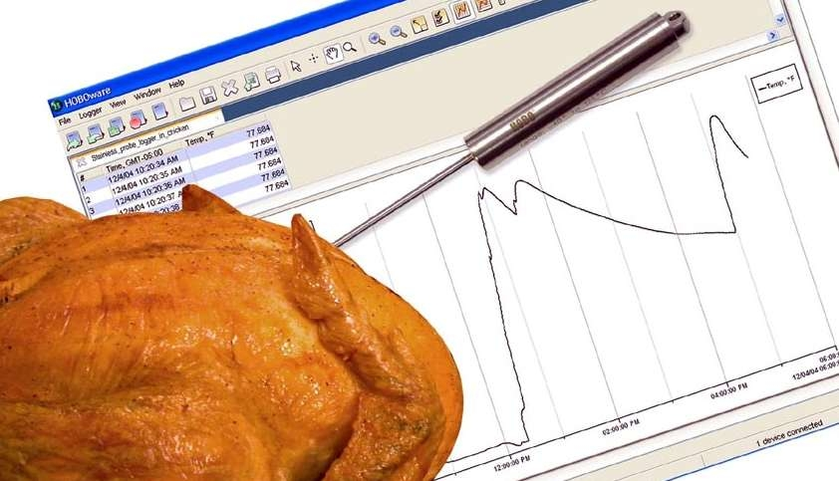
Cooking - CCP
Cooling - CCP
Individual portion size (approx. 350g) 90 mins
Large joints within 4 hours
Thermometers should have an accuracy of +/-5°c

Slide 68
MICROBIOLOGY AND VP/MAP

Slide 69
Think Risk!
Hazard Identification
- What is the problem - What is the hazard (pathogen, toxin?) - Which foods are associated
Exposure Assessment
- What is the level of the hazard in the food eaten? - How much of the food is eaten? - How often is the food eaten?
Hazard Characterisation
- Which consumers are vulnerable? - At what level(s) does the hazard cause illness? - What are impacts on consumer health?
Risk Characterisation
- What is the risk to consumers and to sub-groups of consumers? - What is the effect of different mitigation actions? - What are key assumptions and uncertainties in the assessment?
Notes:
Basic framework is applicable across all hazards
Hazard identification
Identify pathogen of concern
Hazard characterisation
Determine the dose-response relationship (volunteers, animals) when possible, or investigate outbreaks
Exposure assessment
Calculate the exposure to the hazard at consumption from hazard level and consumption volume/frequency
Risk characterisation
Combine exposure and dose-response to obtain and estimation of the prevailing risk level or rate of illness

Slide 70
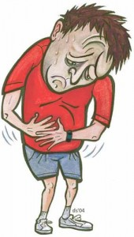
Hazard ID. Which microbes are of concern (reasonably likely to occur)?
Viruses:
Will not grow in food, may be transmitted via VP/MAP foods as per other foods
Yeasts and Bacteria:
Yeasts can cause spoilage.
Bacteria cause the majority of food poisoning and food spoilage in VP/MAP.

Slide 71
Focus on Bacteria....
Obligate Aerobes (Require O₂)
Obligate Anaerobes
(Require Absence of O₂)
Facultative Anaerobes (can grow in presence or absence of O₂)

Slide 72
Organisms that grow in low O₂ environment ?
Pathogens | Spoilage
Clostridium botulinum | Lactic Acid Bacteria
Staphylococcus aureus | Enterobacteriaceae
Salmonella | Yeasts
Bacillus cereus
Listeria monocytogenes
Escherichia coli
Clostridium perfringens
Vibrio parahaemolyticus
Yersinia enterocolitica
Aeromonas hydrophila

Slide 73
Pathogens/Food combinations of particular concern
Pathogens | Food Type
Clostridium botulinum | Chilled foods, any VP product conducive to growth.
Staphylococcus aureus | Food that has been handled, low Aw foods.
Salmonella | Most foods, particularly neutral pH / high Aw
Bacillus cereus | Starchy foods e.g. rice
Listeria monocytogenes | RTE Products
Escherichia coli | Cooked meats, high fat foods, raw milk
Clostridium perfringens | Cooked meats, gravies etc.
Vibrio parahaemolyticus | Water, and associated foods (shellfish, salads)
Yersinia enterocolitica | Milk, Pork, Tofu, Water
Aeromonas hydrophila | Water, and associated foods

Slide 74
Hazard ID – C.botulinum

Slide 75
Hazard ID – C.botulinum
Concern has typically focused on the potential growth of C. botulinum

Slide 76
Clostridium botulinum
Two important groups for human disease:
Non-Proteolytic | Proteolytic
Chilled Foods | Canned Foods
Grows at chill temperature (above 3°C) | Cannot grow at chill temperature (below 10°C)
Less heat resistant (D_{82.2} = 32.3min) | More heat resistant (D₁₂₁ = 0.13 min)
All produce toxins and spores.

Slide 77
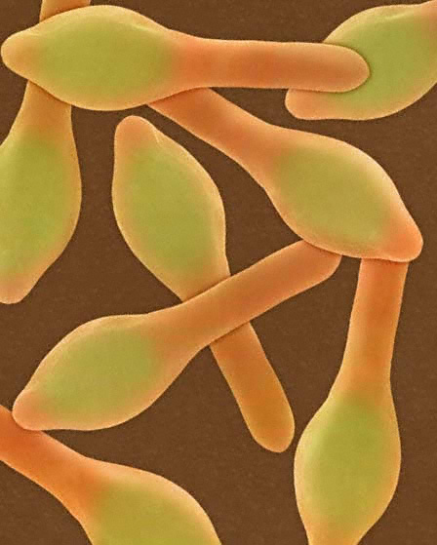
Clostridium botulinum
Source:
Soil, water and silt
Foods involved:
Canned foods,
meat products,
milk products
fish and vegetables.
Honey (infants)
Spores may survive pasteurization or recontaminate - geminating later in anaerobic conditions.
Incidence: Rare in UK:
30 cases in 1989,
1 case in 2005
USA has 40-80 cases/year

Slide 78
Hazard ID – L.monocytogenes
L. monocytogenes has also been in focus…
…In VP smoked and cold-salted fish, other RTE meat products

Slide 79
Hazard ID – L.monocytogenes
…In MAP produce
increase in shelf life without affecting the growth of L. monocytogenes
pathogen able to grow at refrigeration temperature
The suppression of the microflora could lead to a situation where in adequately refrigerated produce, L. monocytogenes could reach high levels before spoilage occurs
Food Control. Vol. 9. No. 6. pp. 321-347, 1998 (Produce ref)

Slide 80
Hazard Characterisation -Clostridium botulinum
Infective dose:
0.005-0.1 micrograms of toxin
Onset time:
12-36 h (Range up to 8 days)
Duration:
Death in 1-8 days or slow recovery over 6-8 months
Symptoms:
Day 1-3 malaise, dizziness, diarrhoea, vomiting
Day 3-8 speech, vision, swallowing affected, death
Convalescence (If antitoxin given)- long and slow

Slide 81
Exposure factors -Clostridium botulinum
Anaerobic and psychrotrophic* organism
Can tolerate elevated CO₂ levels - some evidence that CO₂ stimulates spore germination
VP has no inhibitory effects
Can grow in low levels of O₂ and produce toxins with no apparent signs of food spoilage
*Can grow at chill temperatures (down to 3°C)

Slide 82
Risk Management – Control of significant hazards in VP/MAP
Intrinsic Factors:
Properties possessed by the food itself (e.g. pH, Aw)
Extrinsic factors:
Conditions imposed on the food (e.g. packaging atmosphere, temperature)

Slide 83
Intrinsic Factors affecting shelf-life of VP/MAP food

Slide 84
How does pH affect microbial growth?

Slide 85
pH minima for microbial growth:
5.0
4.5
4.0
3.5
2.0
C. perfringens
C. botulinum
S. aureus
Yeasts and Moulds
E. coli
Lactic Acid Bacteria
L. monocytogenes
B. cereus
B. coagulans
Salmonella spp.

Slide 86
pH range of food
FOOD GROUP FOOD pH
Meat Chicken 5.1-6.2
Beef 6.2-6.4
Fish Cod 6.6-6.8
Tuna 5.2-6.1
Dairy Milk 6.3-6.5
Cheddar Cheese 5.8
Buttermilk 4.5
Fruit Apples 2.9-3.3
Limes 1.8-2.0
Oranges 3.6-4.3
Melon 6.3-6.7
Vegetables Carrots 4.9-5.2
Potatoes 5.3-5.6
Cabbage 5.4-6.0

Slide 87
Water Activity (A_{w})
Measure of “available water” in a system
Different from moisture content
Partial vapour pressure of water in equilibrium with the sample
= A_{w}
Partial vapour pressure of pure water at the same temperature

Slide 88
Aw minima for microbial growth:
1.00
0.95
0.90
0.85
0.60
Pseudomonas
E. coli
Lactobacillus
Micrococcus spp.
C. botulinum
C. perfringens
Salmonella
S. aureus (aerobic)
Listeria monocytogenes
Staphylococcus aureus (anaerobic)
Bacillus spp. (aerobic)
Most yeasts and moulds
Osmophilic yeasts and xerophilic moulds

Slide 89
A_{w} ranges for food
Product | A_{w}
Milk | 0.99 - 1.00
Beef | 0.96 - 0.99
Cheese | 0.90 - 0.96
Jam | 0.80 - 0.91
Fruit Cake | 0.73 - 0.83
Cereal | 0.65 - 0.71
Dried Fruit | 0.60 - 0.75

Slide 90
Extrinsic Factors affecting shelf-life of VP/MAP foods

Slide 91
Temperature

Slide 92
Temperature
Microbes have different optimum growth temperatures

Slide 93
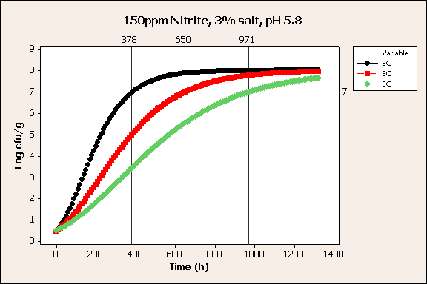
Temperature
Good temperature control can double shelf life.
8°C = 15d
5°C = 27d
3°C = 40d
Meat spoilage model produced using Campden BRI ‘Forecast’ software.

Slide 94
Other Extrinsic Factors:
Storage conditions e.g. relative humidity
Packaging atmosphere........others?

Slide 95
Controlling C. botulinum in chilled VP/MAP products
A chilled shelf life of 10 days or more is possible if one or more of the following are met:
pH of 5 or less throughout the product
Aw of 0.97 or less throughout the product
Heat treatment of 90°C for 10 minutes or equivalent throughout the product.
Salt of 3.5% (aq) or greater throughout the product.
Any combination of factors proven to inhibit growth or toxin production by C. botulinum.
Proteolytic strains controlled by temp <10°C (non-proteolytic <3°C)

Slide 96
What else can be done to control C.botulinum in VP/MAP foods?

Slide 97
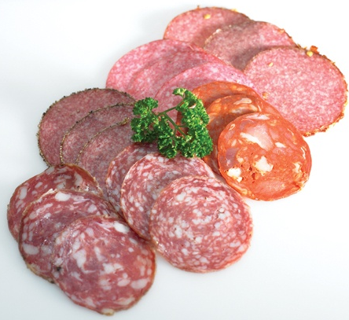
Nitrite – cured meat products
Nitrite is primarily a curing agent – provides meat colour, flavour, texture and serves as an anti-oxidant
Usually sodium (NaNO₂) or potassium (KNO₂) nitrite, but also nitrate salts (E249-E252)
Particularly effective against Clostridia – variable for other microbes
Control over fermentation needed to prevent conditions favourable to growth of other microorganisms

Slide 98
Nitrite – cured meat products
Amounts (maximum, maximum residual) and products are specified in Directive 95/2/EC (food additives)
Typically 50-150 mg/kg nitrite is necessary to inhibit the growth of C. botulinum (salt/Aw, pH, cooking and storage parameters also impact)
Input levels (vs residual) are important for C.botulinum control (EFSA Journal (2003) 14, 1-31)
Concern re acute effects of nitrite consumption controlled by use of salt mixes

Slide 99
Lactic Acid and its salts
Used for centuries in fermented / cultured products (cheese, sauerkraut etc.)
Modern usages: Salt replacement, water retention in meat products, colour retention.
Several studies have shown an antimicrobial effect at relatively high final concentration (approx .1 – 3%)
Possible antimicrobial effect on C. botulinum.
Campden BRI data: R&D 277

Slide 100
Interactions between factors: Hurdle technology.
Hurdle technology – a combination of factors, when used together result in a safe design
One intrinsic factor alone may not be enough to inhibit microbial growth (e.g. Low-ish pH of 5.8)
Low-ish pH and some salt in combination with each other may inhibit growth.

Slide 101
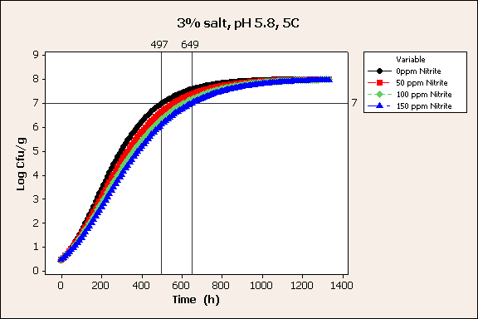
Examples: pH and Nitrite
Shelf life extended from 20 days to 27 days using nitrite.
Meat spoilage model produced using Campden BRI ‘Forecast’ software.
Publically available models are available e.g. DTU Food Safety and Spoilage Predictor (FSSP)

Slide 102
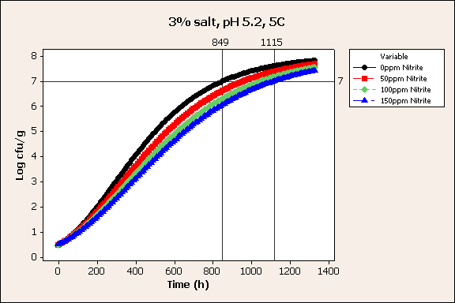
Examples: continued
Lower pH and nitrite gives shelf life of 46 days.
Meat spoilage model produced using Campden BRI ‘Forecast’ software.
Publically available models are available e.g. DTU Food Safety and Spoilage Predictor (FSSP)

Slide 103
Shelf Life determination and VP/MAP

Slide 104
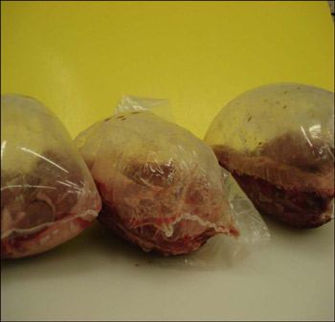
Factors limiting shelf life
Often spoilage organisms – e.g. Lactic Acid Bacteria (LAB), Enterobacteriaceae (non-pathogenic), Spore-formers (e.g. Bacillus, Clostridium spp.)
Other quality changes e.g. in colour, taste, texture
Potential for pathogen growth
C. botulinum/L. monocytogenes in particular subject to regulatory controls
Low temperature growth of Clostridium estertheticum (<0°C)
Causes ‘Blown Pack’ spoilage of chilled VP meat.
Image courtesy of TEAGASC

Slide 105
Greening of meat
“Iridescence is a common problem in sliced roast beef and ham products. The dominant color is frequently green and consumers sometimes confuse this with green myoglobin pigments associated with microbial growth. The iridescence of meat products is produced by a combination of the angle of incidence of the light on the muscle fibres and the wetness of the surface. If the fibres are pulled slightly out of alignment during slicing, the light strikes the fibre at an angle scattering light which appears as the rainbow or greenish color on the surface of the meat. Addition of phosphate seems to exacerbate the problem by increasing the amount of water that is retained by the product.”
Jane Ann Boles - The Saskatchewan Food Product Innovation Program

Slide 106
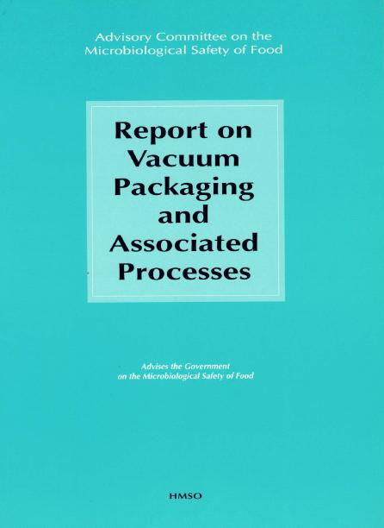
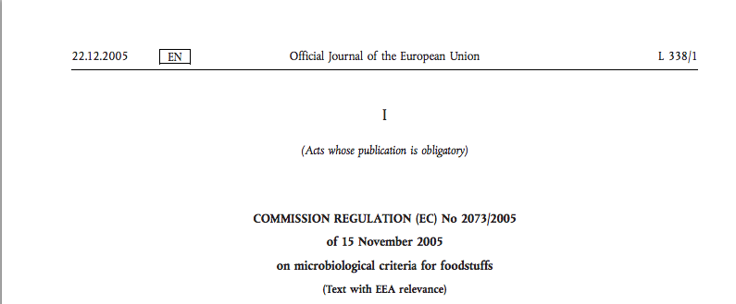
Pathogens our primary concern

Slide 108
Shelf-life of chilled VP/MAP products limited by C. botulinum requirements
<10 days unless one or more of the following are met:
pH of 5 or less throughout the product
A_{w} of 0.97 or less throughout the product
Heat treatment of 90°C for 10 minutes or equivalent throughout the product.
Salt of 3.5% (aq) or greater throughout the product.
Any combination of factors proven to inhibit growth or toxin production by C. botulinum.

Slide 109
“I’ve opened this Vac Pack, it’s been exposed to air so I get another 10 days when I re-pack it, right?”
WRONG!!
C. botulinum produces spores which can survive in air, going on to grow and produce toxin on re-pack.

Slide 110
....so what do you do about re-packing sliced meats etc?
If the product is not re-contaminated during slicing and re-pack, and the specified storage temperature is adhered to, the original shelf life applies (i.e. if a joint has a 20 day life and is sliced on day 5, the slices have a 15 day life).
Underpinned by good Food Safety Management systems i.e. GHP, GMP and HACCP
Subjective assessment of operators control
Decision will also depend on the validity of the original shelf life assignation

Slide 111
“The practice of giving a ‘rolling 10 day shelf-life’ is of great concern. If a VP/MAP product is unwrapped, e.g. for slicing or portioning, and then rewrapped, the shelf-life given to the re-wrapped product should not exceed the shelf-life given to the original product. Where the re-wrapped shelf-life is to be greater than 10 days then this ought to be justified with respect to controlling factors to prevent the growth of non-proteolytic C. botulinum.”
2008 FSA VP Guidance:

Slide 112
My product doesn’t meet any of the 10-day criteria, do I have to go to the expense of a challenge test?
Alternatives to the ‘10 day rule’
C. botulinum will not grow below 3°C
Superchill/deep chill
Freeze
Modelling
Challenge testing
Risk assessment

Slide 113
Listeria monocytogenes and shelf life (SL)
Is there evidence that the organism is unable to grow? I.e.
Intrinsic (or extrinsic) factors preclude growth, on own or in combination
Backed up by references/models/data
L.m. not the limit for SL – must meet criteria specified
If growth is possible:
SL determined by requirement to maintain level <100cfu/g
Demonstrated to ‘satisfaction of competent authority’
If not demonstrated, absence criteria apply

Slide 114
Challenge Testing
Laboratory simulation of microbe fate over a product’s life
Inoculation of specific organisms likely to occur (and limit SL), or validated surrogate(s) that are representative
Sampled at specific intervals (including end of SL) to determine survival/growth
Storage conditions appropriate for product, including foreseeable misuse
Expensive

Slide 115
Predictive Modelling
Swift & cheap
Only Temperature, pH and Aw data needed.
Provides a prediction of shelf life for spoilage or pathogenic organisms.
Does not provide the same level of confidence as a challenge test.
Often used during NPD (new product development) as confirmation of the effects of recipe changes.

Slide 116
Is a predictive model good enough to be confident of safety?
Models tend to be ‘fail safe’ rather than ‘fail dangerous’ i.e. give conservative estimates of shelf life.
Trusted models, sources e.g.
IFR Combase (http://www.combase.cc/)
USDA Pathogen Modeling Program (http://pmp.errc.ars.usda.gov/PMPOnline.aspx)
Wise to compare outputs, understand limitations

Slide 117
Risk Assessment
Paper exercise that can incorporate literature findings, predictive models and challenge test data
Outlines the relevant hazards, their ability to grow to levels that could cause illness
Underpins operator HACCP plans, and/or decisions on food safety management controls
Responsibility of FBO, but EHO understanding required

Slide 118
GUIDANCE FOR FOOD ENFORCEMENT OFFICERS

Slide 119
Powers exist in the Food Hygiene (England) Regulations 2013 and equivalent legislation in Scotland, Wales and Northern Ireland, to issue a hygiene emergency prohibition notice where there is evidence that there is an imminent risk to consumers.
Before considering such action, the local authority should consider the advice contained in this document and other references therein and seek advice of an appropriate expert who may be able to provide evidence in court on behalf of the authority if their action is challenged.
The seizure of food and the possibility of product recall would also need to be considered. In considering whether enforcement action is appropriate or necessary it should be recognised that the advice of the Advisory Committee for the Microbiological Safety of Food (ACMSF) is based on best scientific advice and industry practice.
There is no specific law across the EU, in the UK or other Member States, that covers the use of VP/MAP technology.

Slide 120
An FBO must be able to identify the hazards associated with their business and the methods to control those hazards and reflect these in the business’s HACCP based food safety management system. Reference to the decision tree will identify those factors that need to be taken into account when a VP/MAP product is repacked.

Slide 121
Legislation:
Food Safety Act 1990
The Food Hygiene Regulations 2013
Relevant Codes Of Practice
Food Law Code of Practice 2015

Slide 122
Useful publications:
The Manufacturer of Vacuum & Modified atmosphere of Chilled Foods Code of Practice - Campden BRI
The Report on Vacuum Packing and Associated Processes – ACMSF
The FSA Guidance and Shelf Life of Vacuum and Modified Atmosphere Packed Chilled Food…..

Slide 123
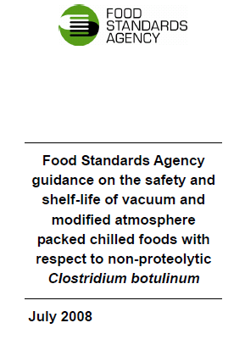
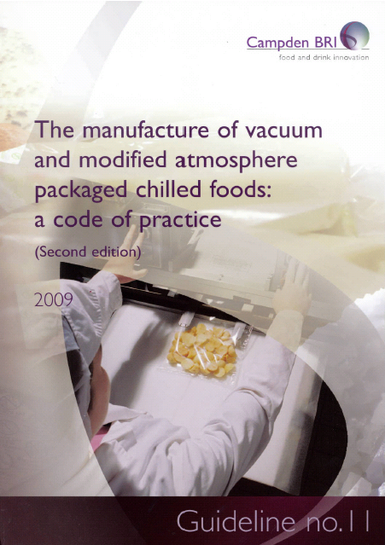

Slide 124
ACMSF
Advisory Committee on the Microbiological Safety of Foods
Set up in 1990, this non-statutory committee provides expert advice to Government on questions relating to microbiological issues and food.
The Committee provides advice in response to requests from the Food Standards Agency and also on matters that Committee members themselves identify as important

Slide 125
Ensure that enforcement action taken is reasonable, proportionate, risk-based and consistent with good practice.
Where relevant liaise with Primary Authority
Unless there is a significant risk follow hierarchy of enforcement
Consider :
The Crown Prosecution Code
The Regulators Code
Enforcement Policy

Slide 126
CASE STUDIES

